Slide 1
Photo Album
by Dpu Barman

Slide 2
118. How to Use Authentication Views with Function Based View in Django

Slide 3
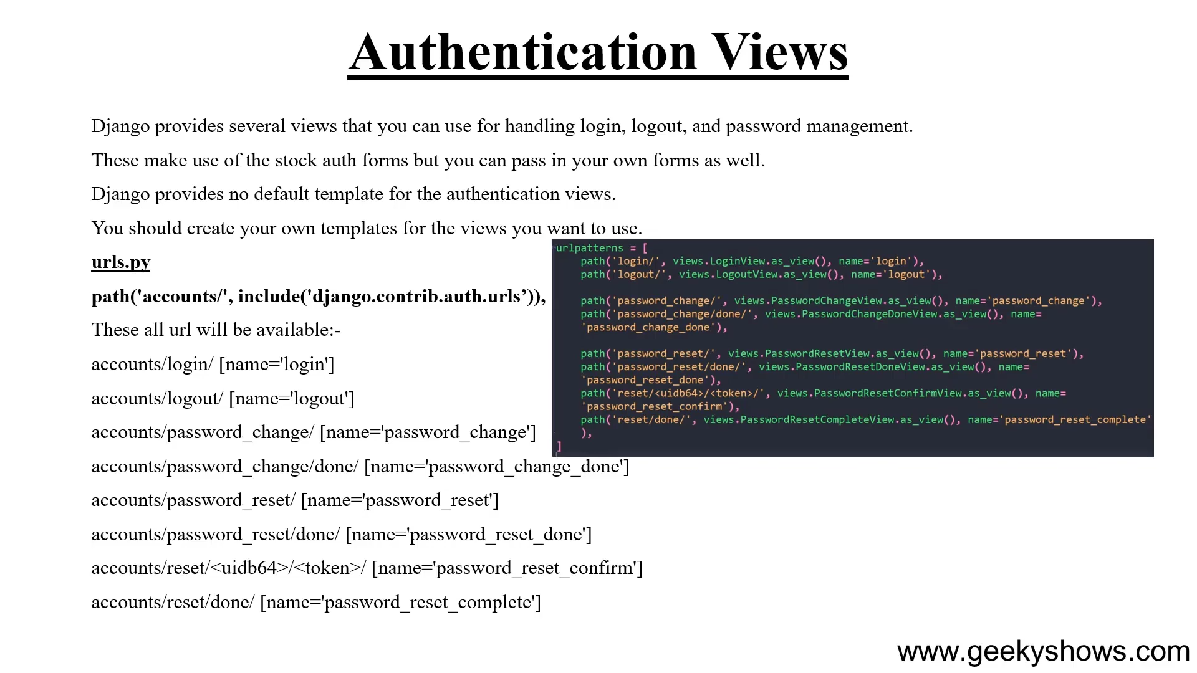

Slide 4
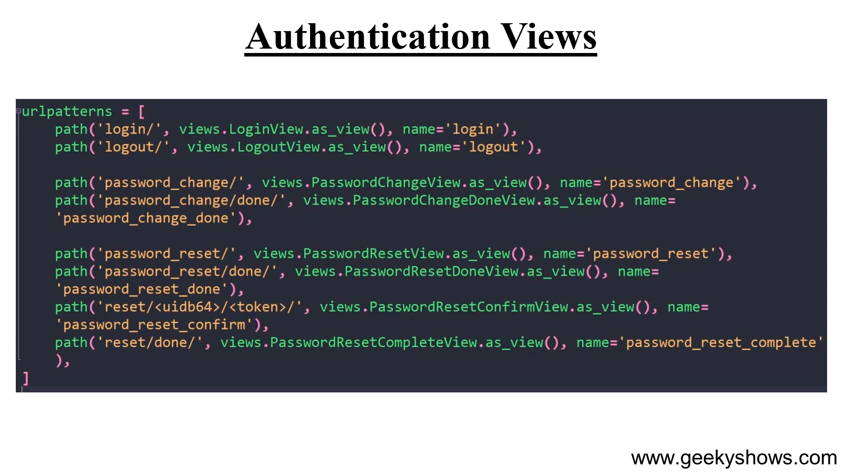

Slide 5
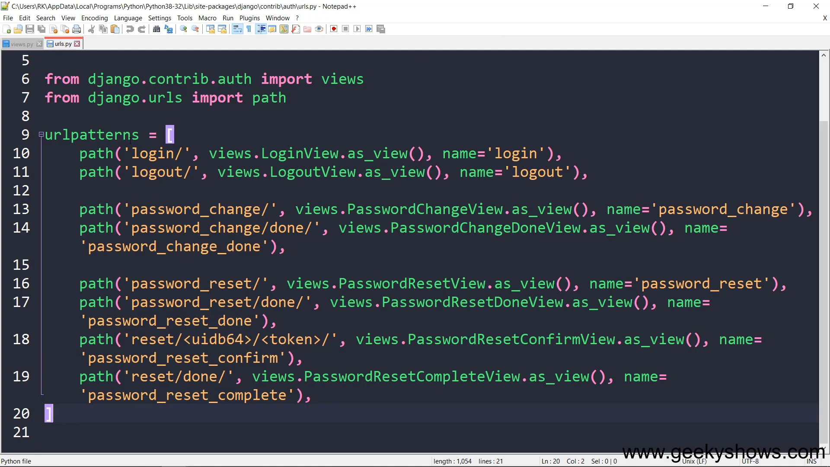

Slide 6
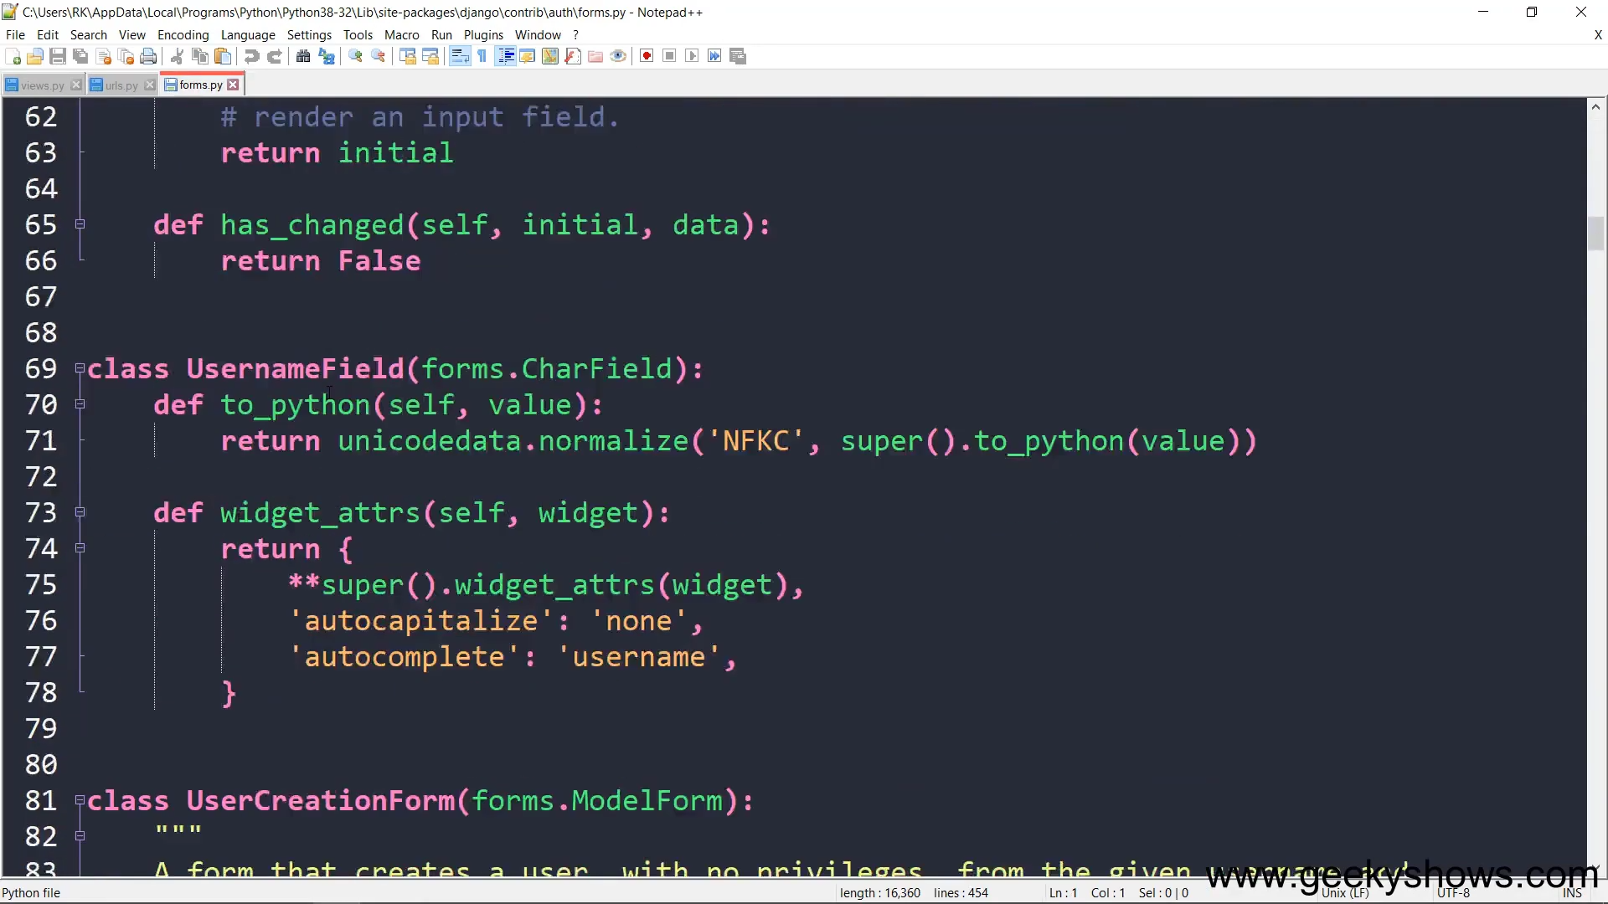

Slide 7
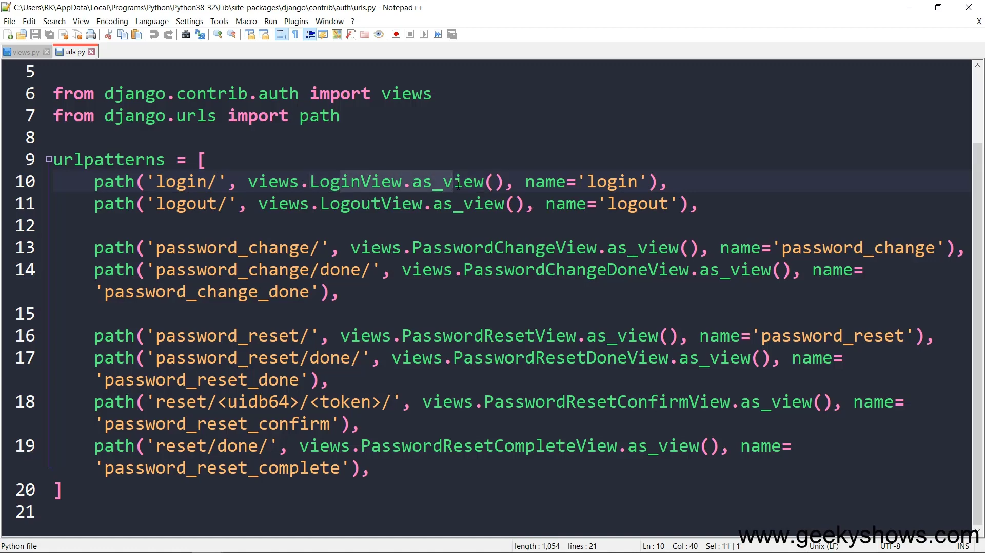

Slide 8
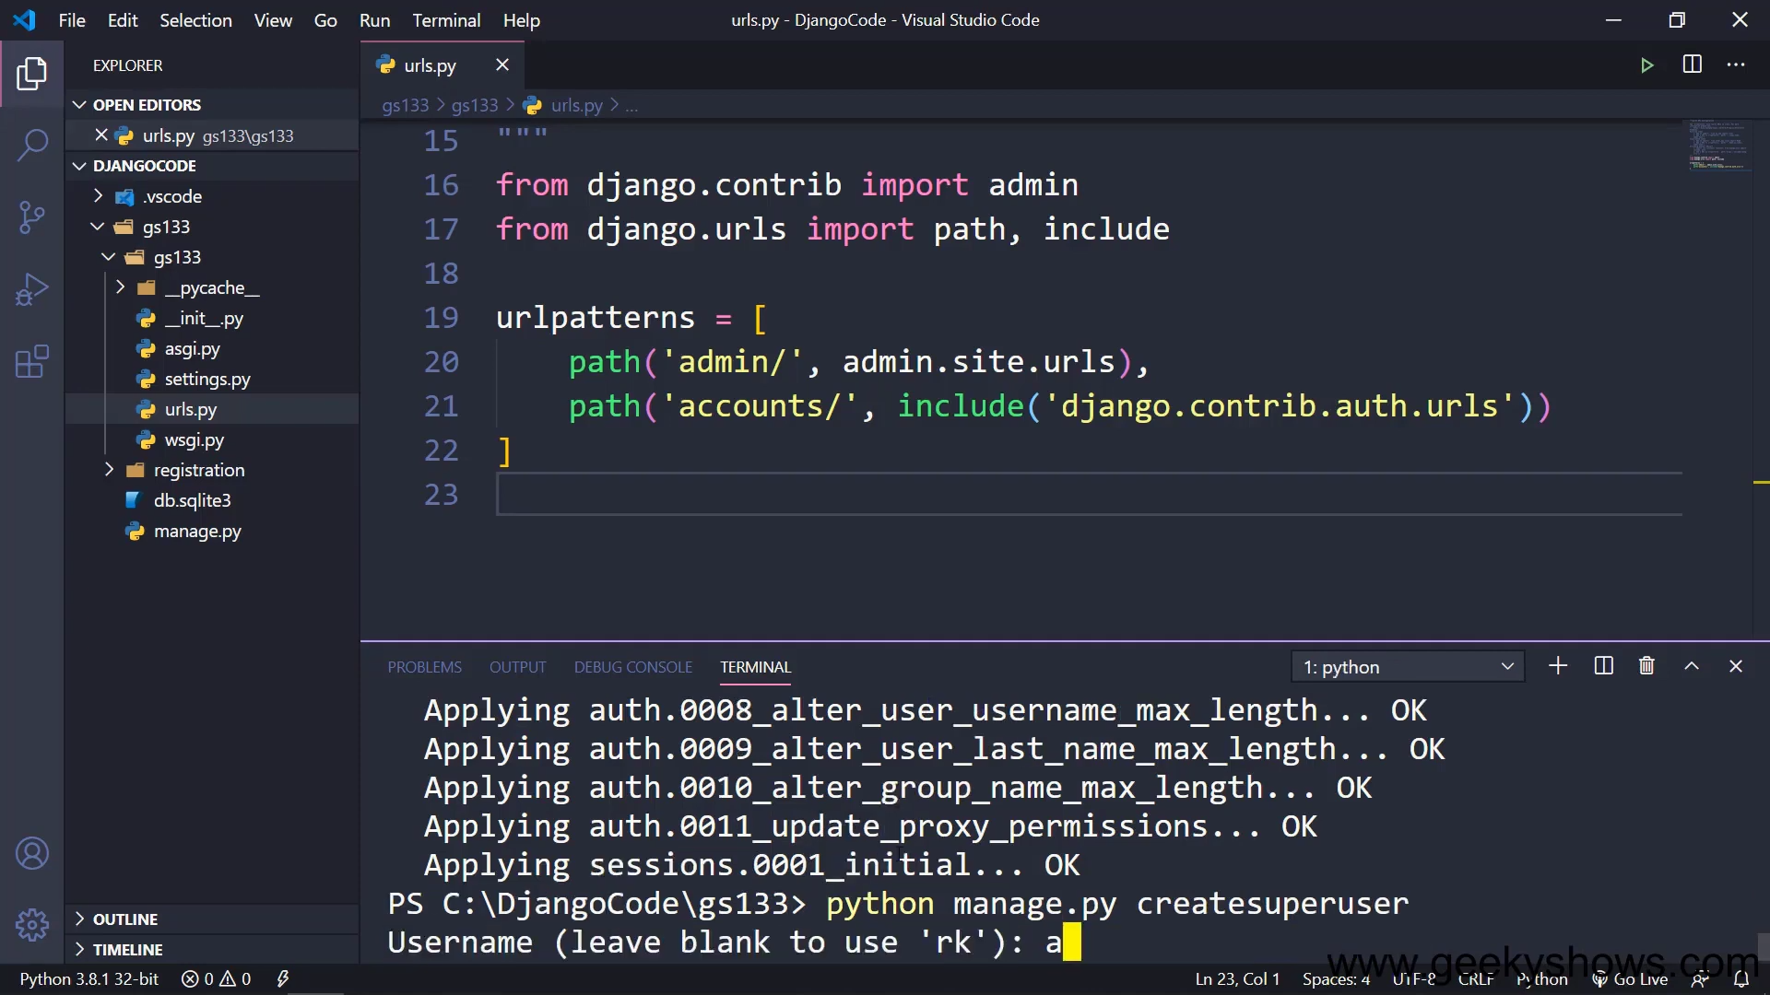

Slide 9
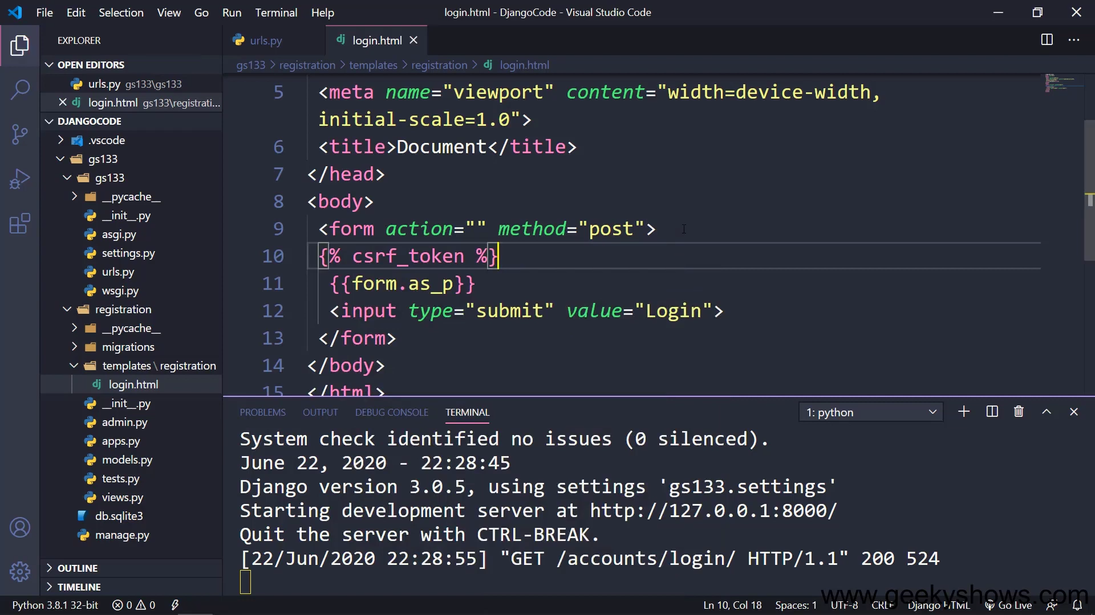

Slide 10
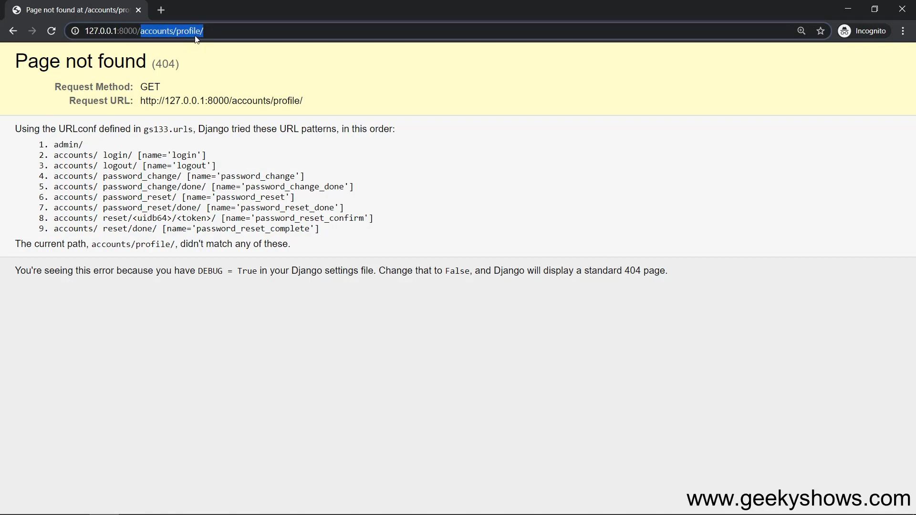
Needs to add this path

Slide 11
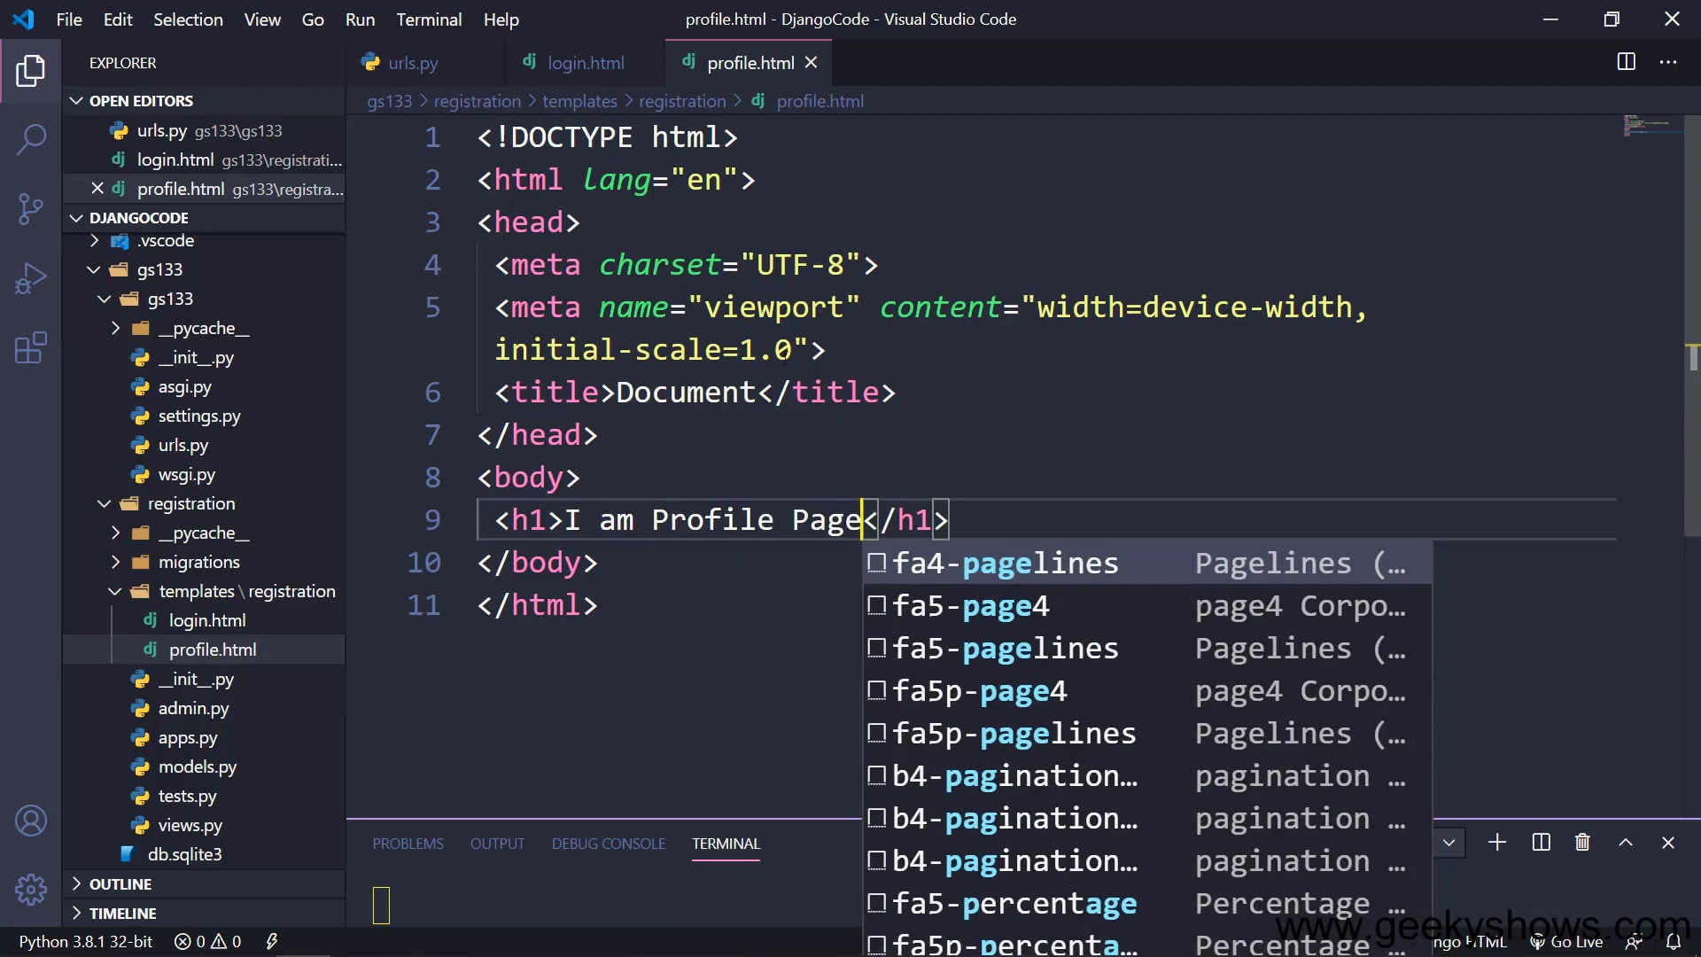

Slide 12
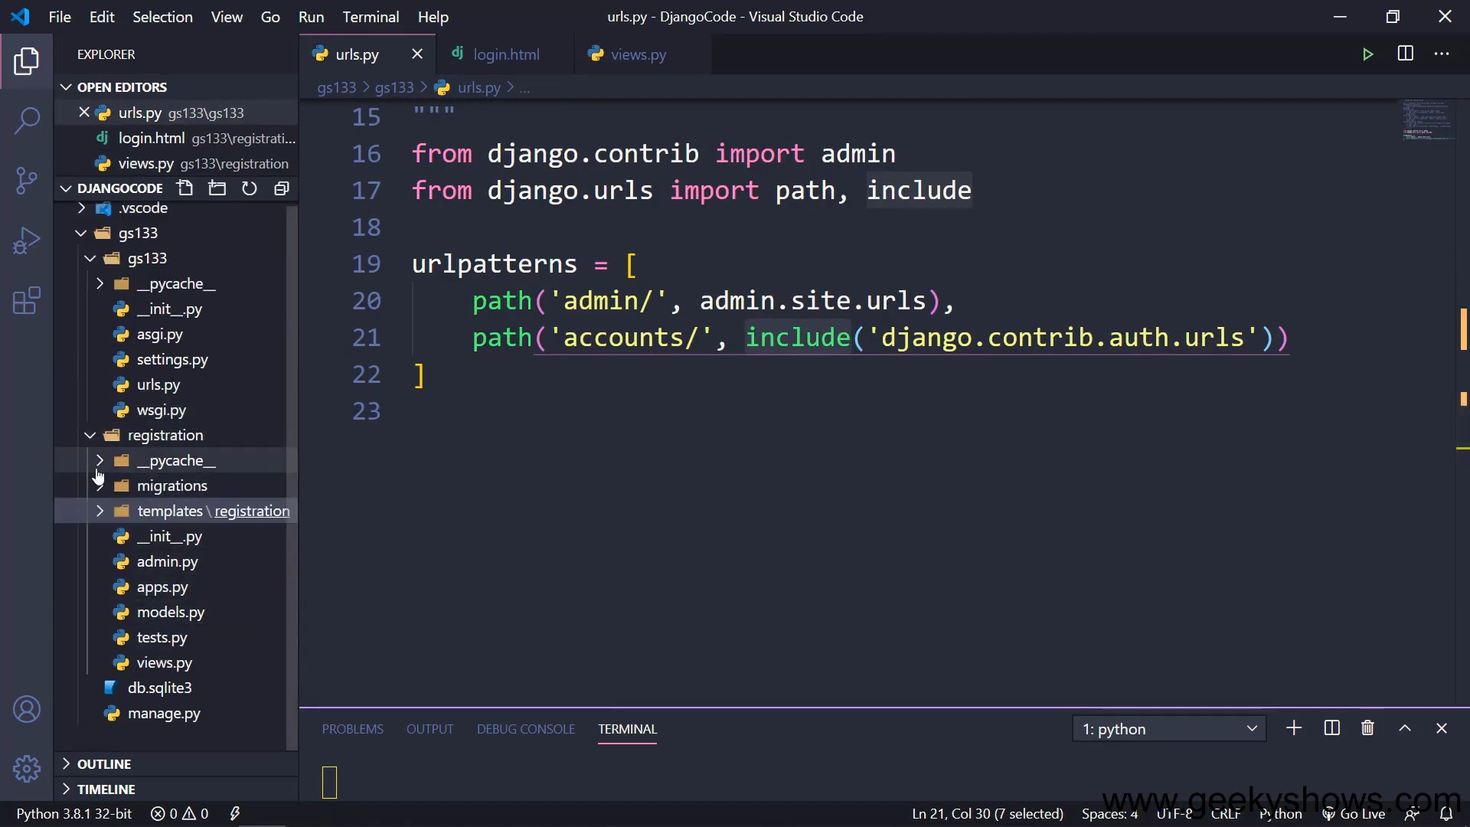

Slide 13
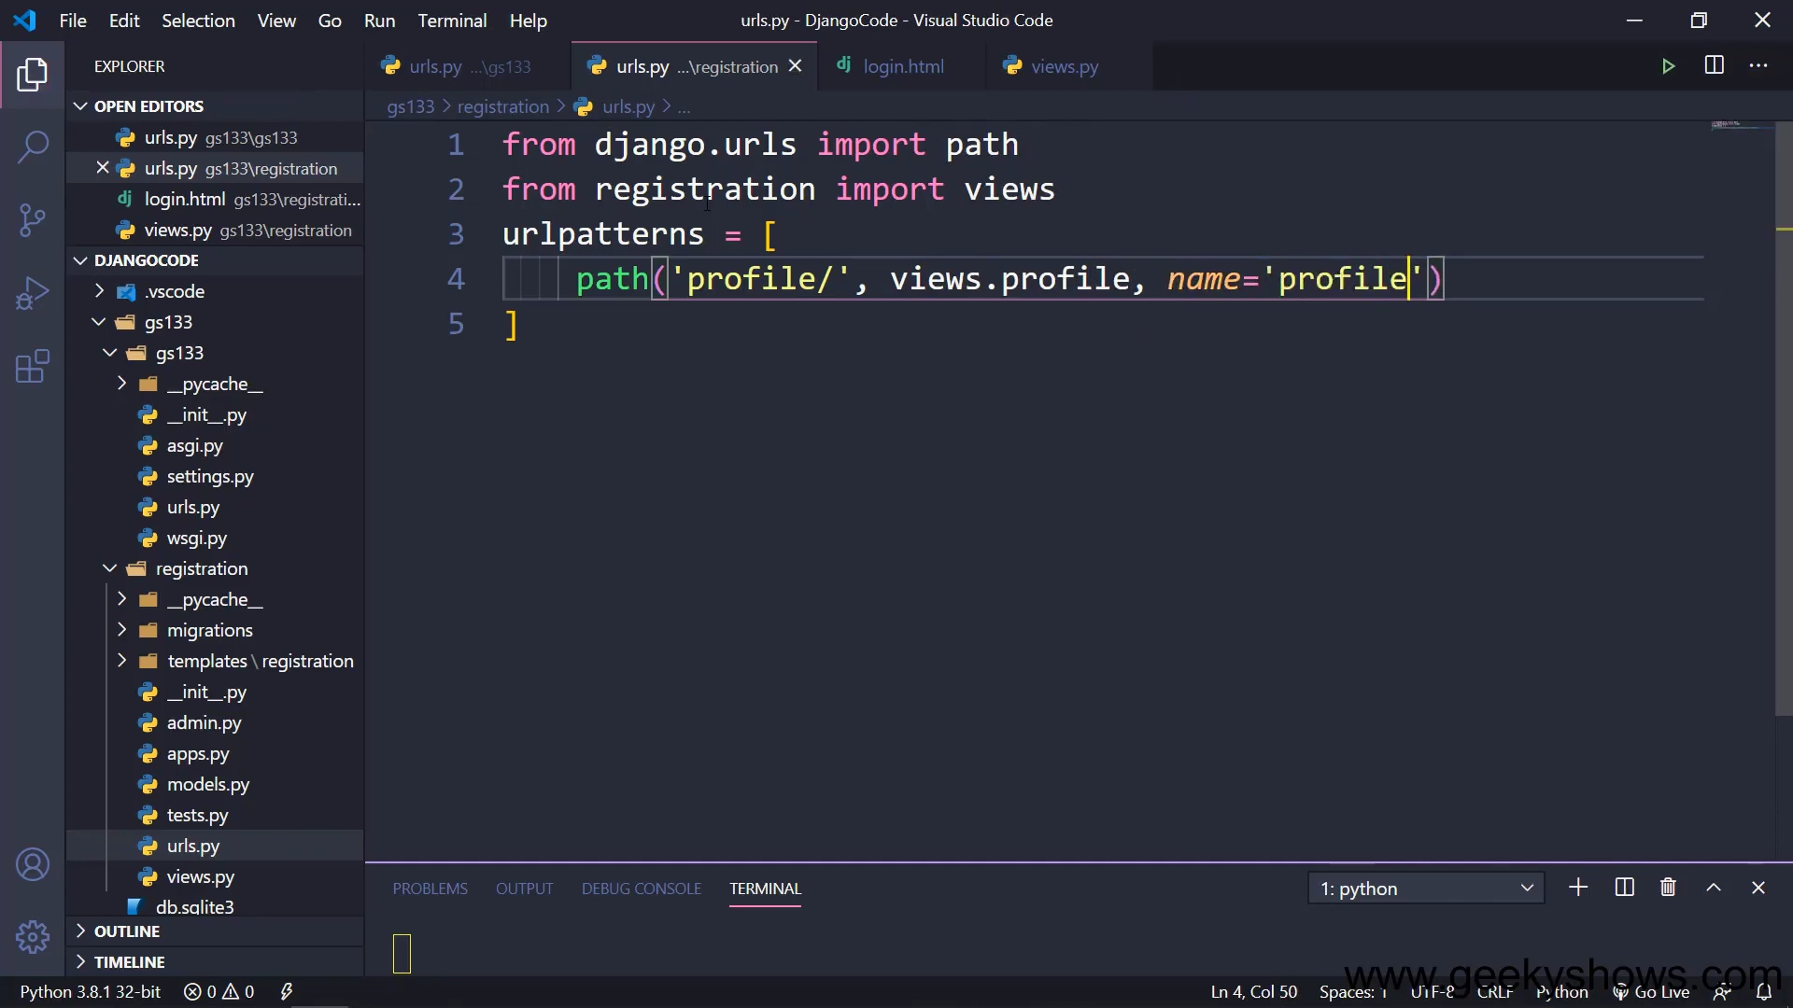
Path after login

Slide 14
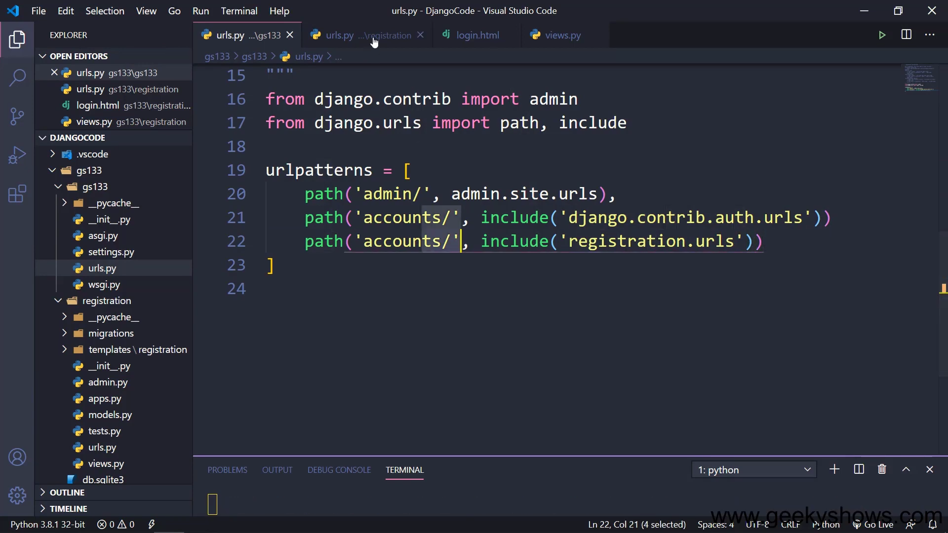

Slide 15
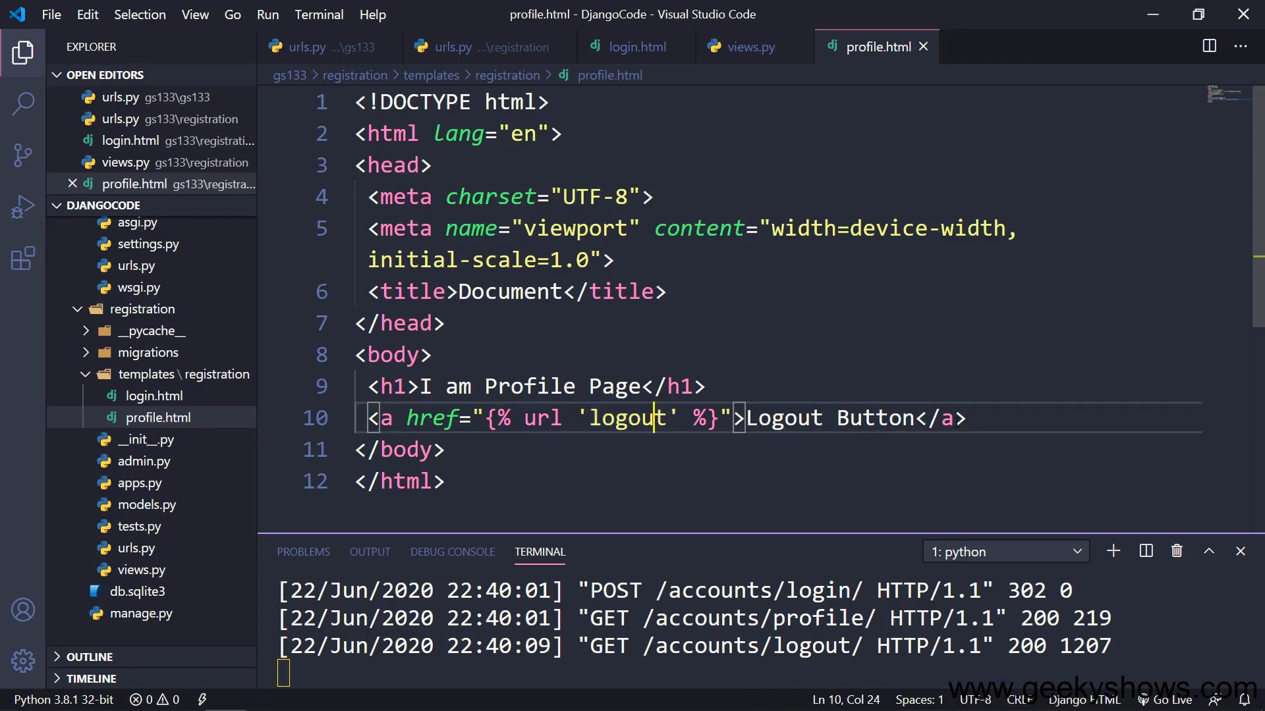

Slide 16
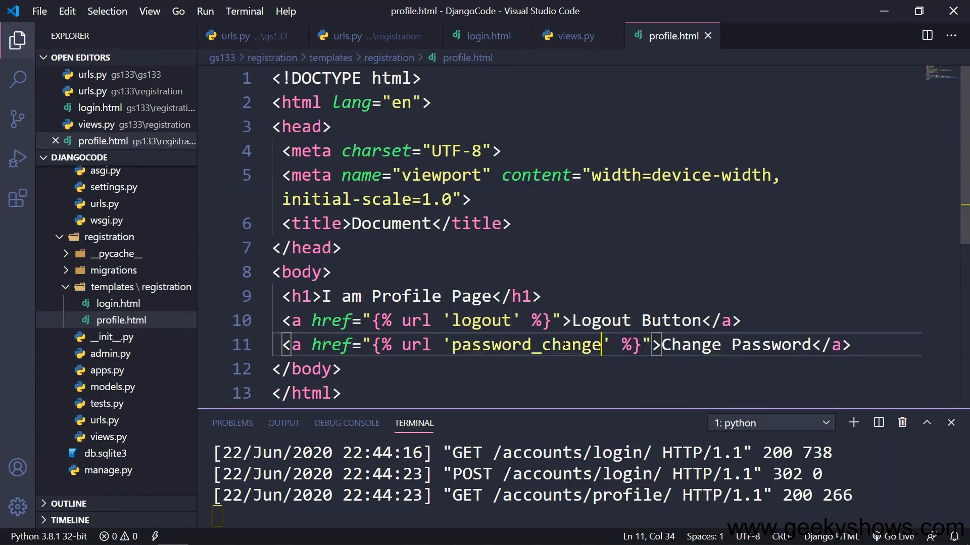

Slide 17
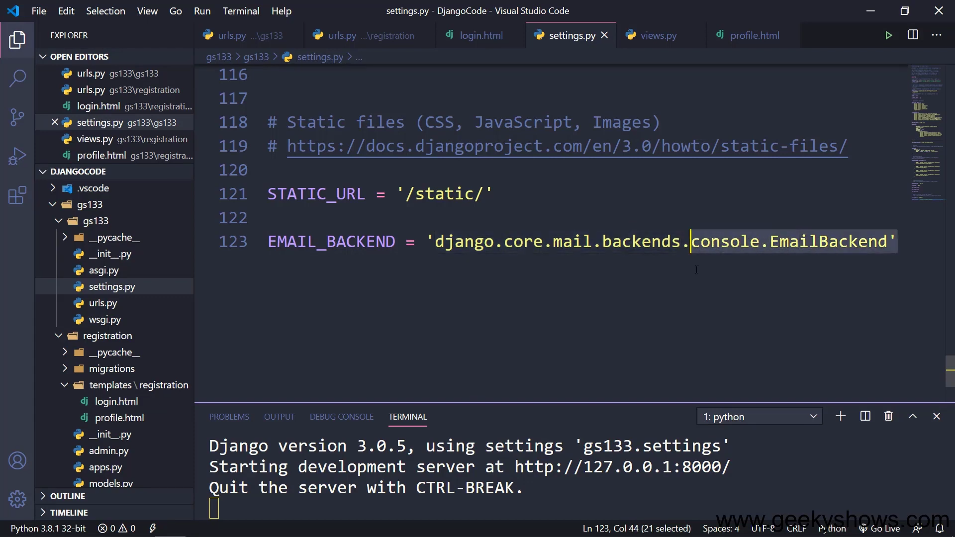
To send password change link to cmd

Slide 18
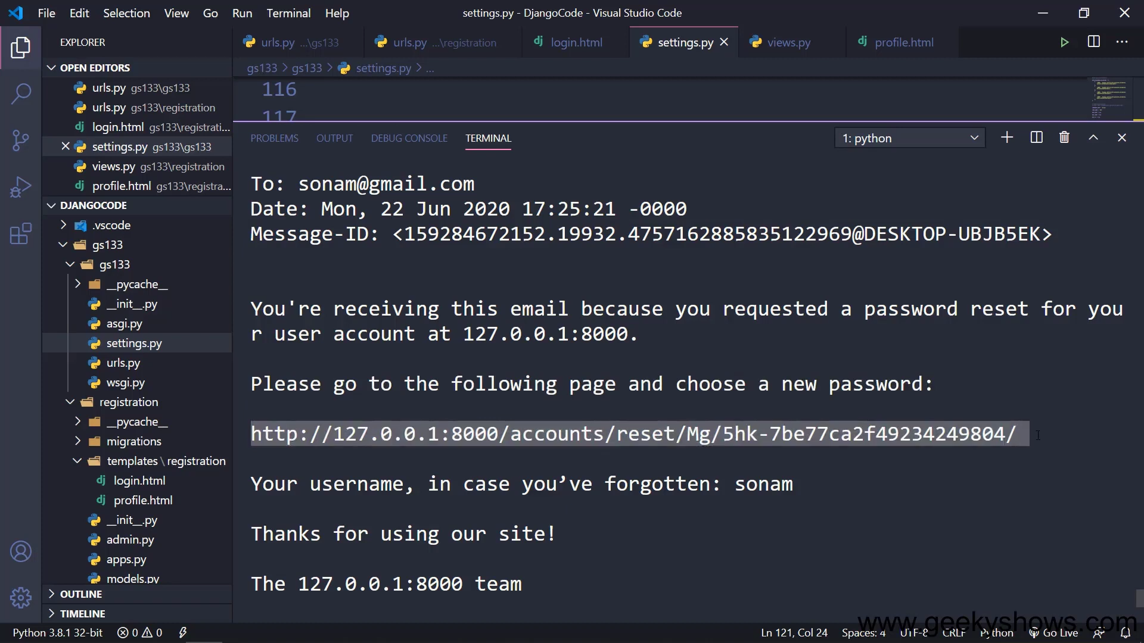

Slide 19
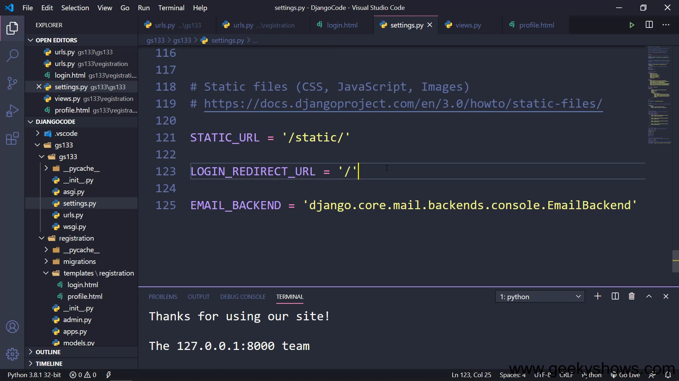
Redirect path after login

Slide 20
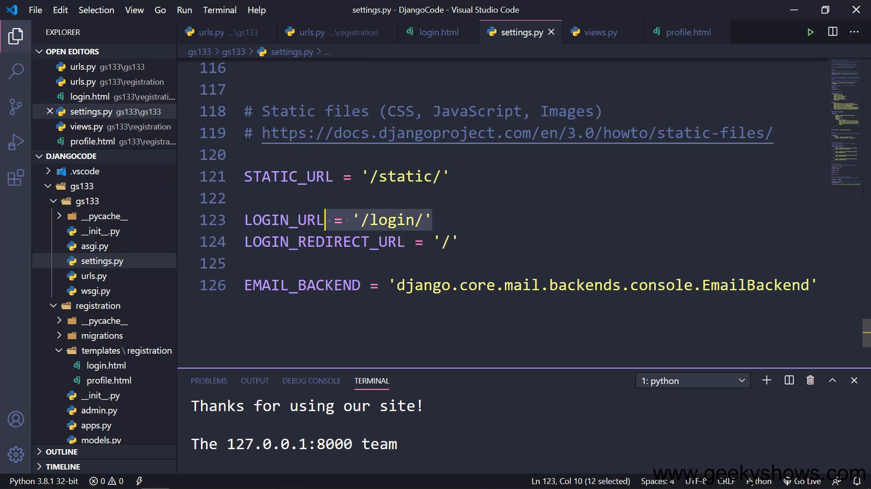

Slide 21
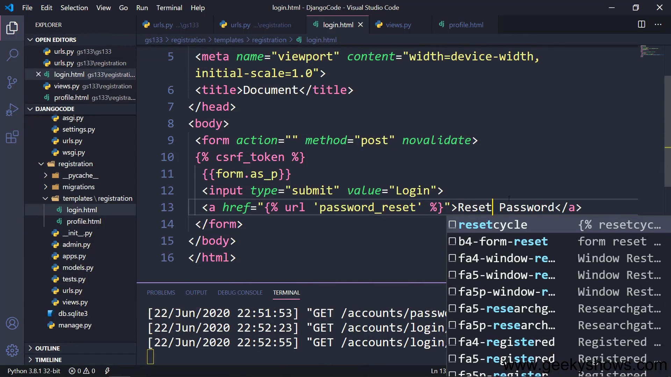

Slide 22
119. Function Based View with login_required and staff_member_required Decorators in Django

Slide 23
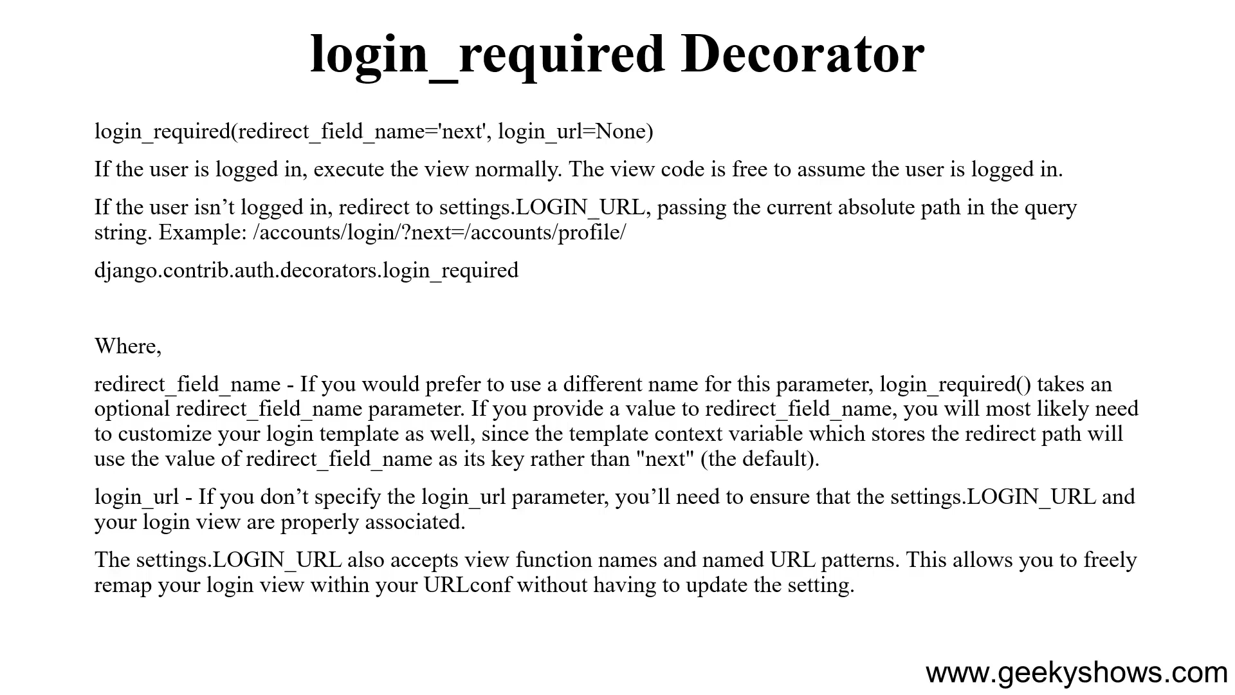

Slide 24
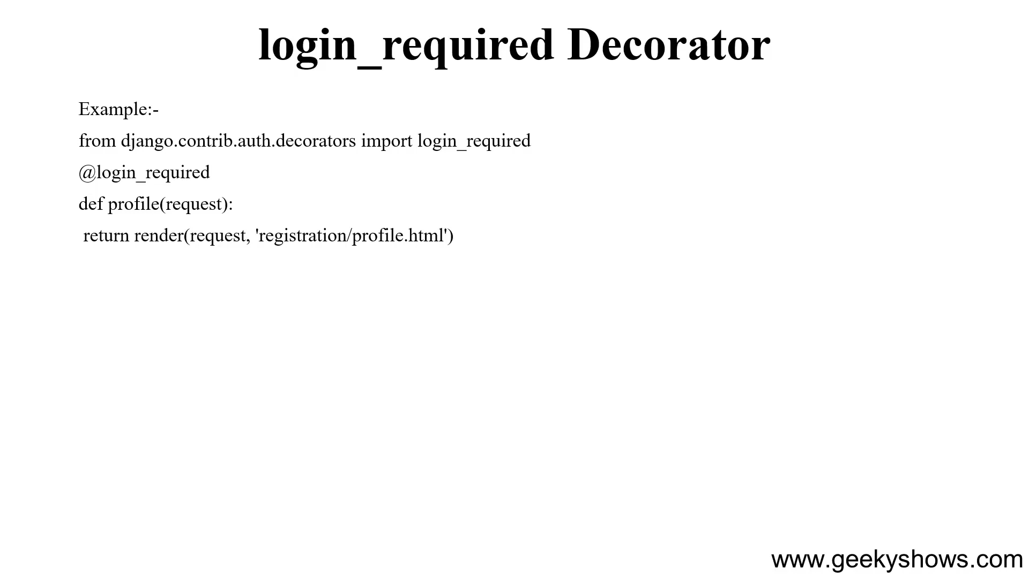

Slide 25
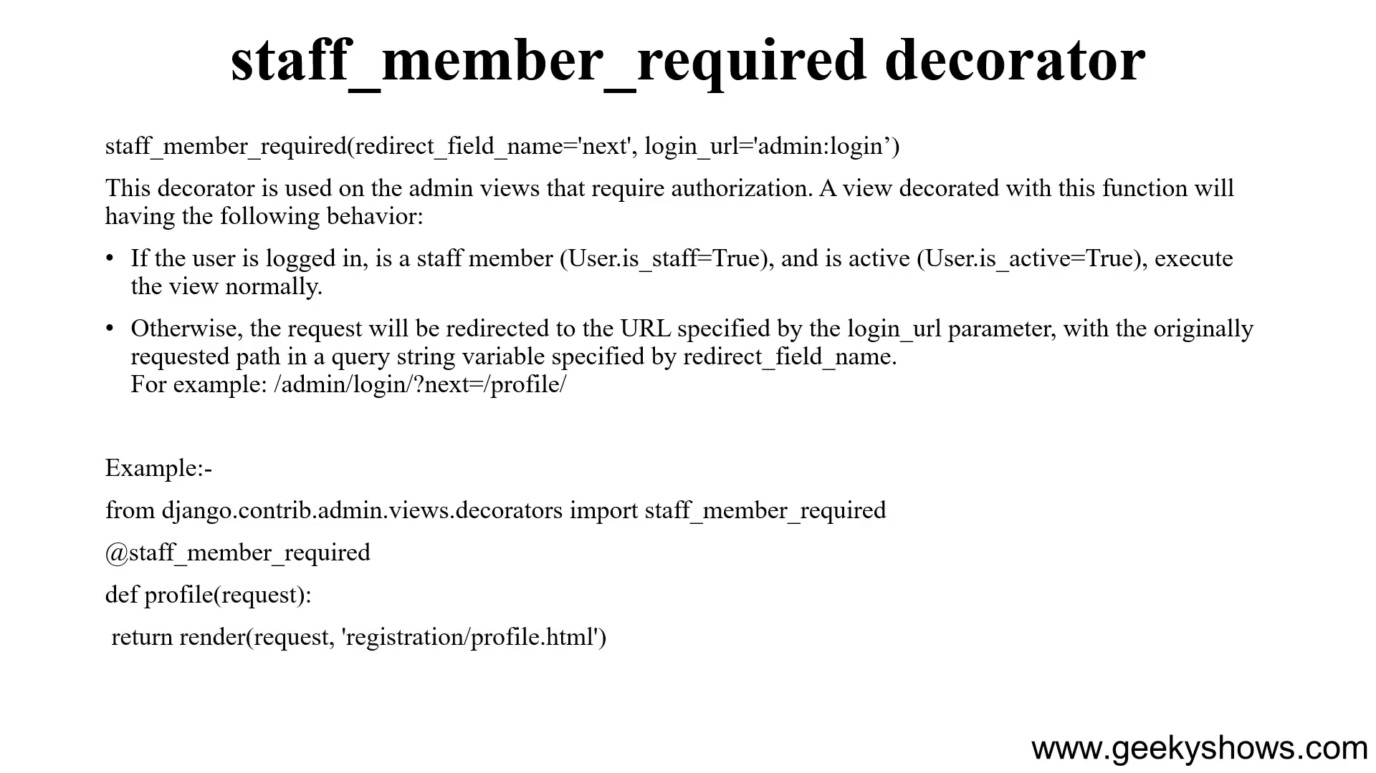

Slide 26
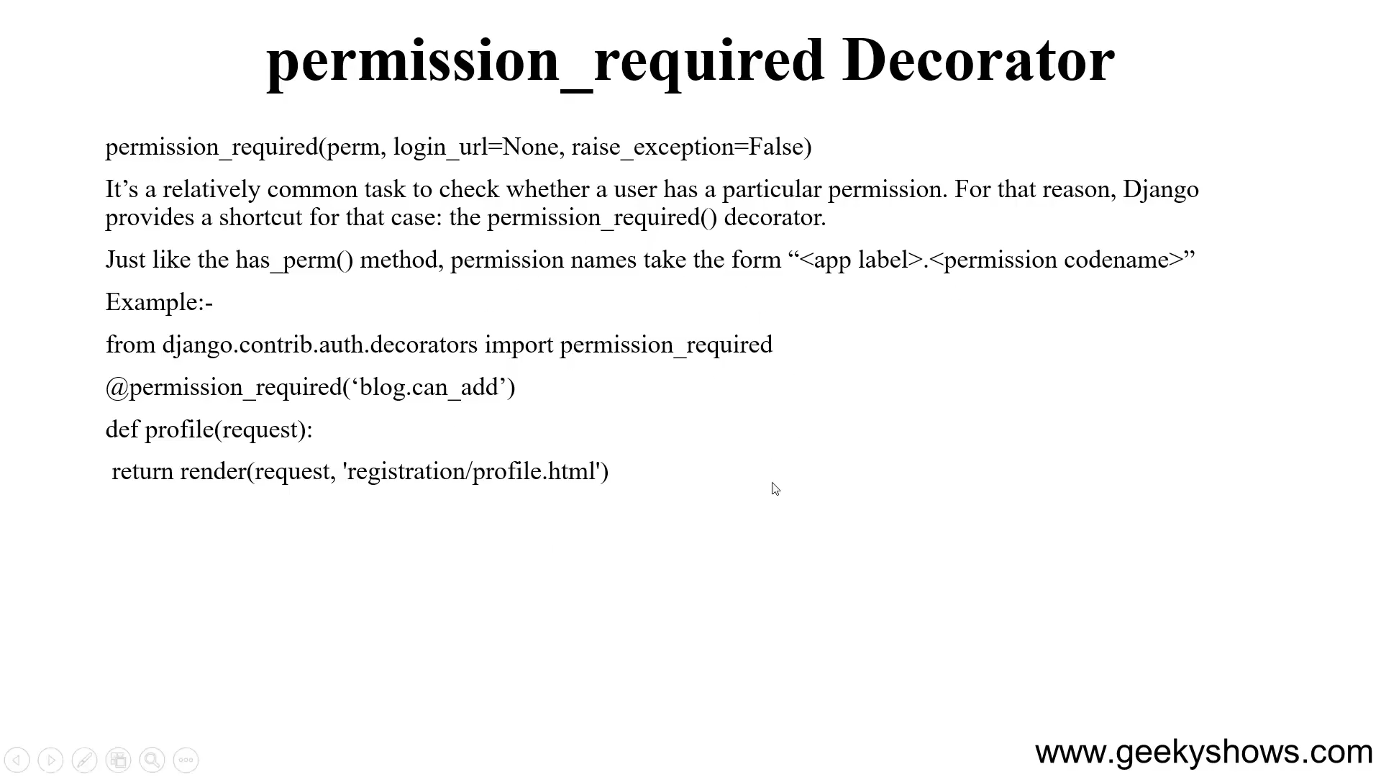

Slide 27
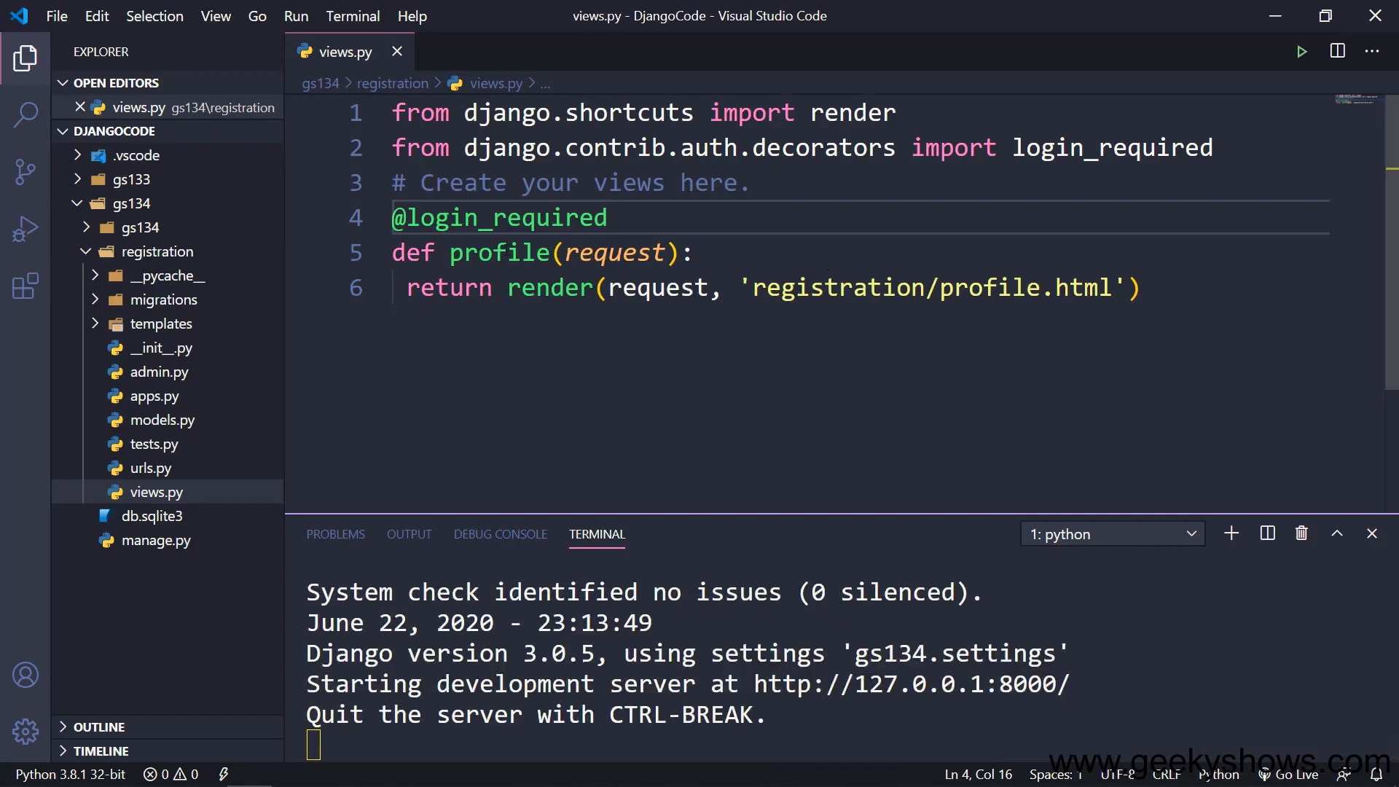

Slide 28
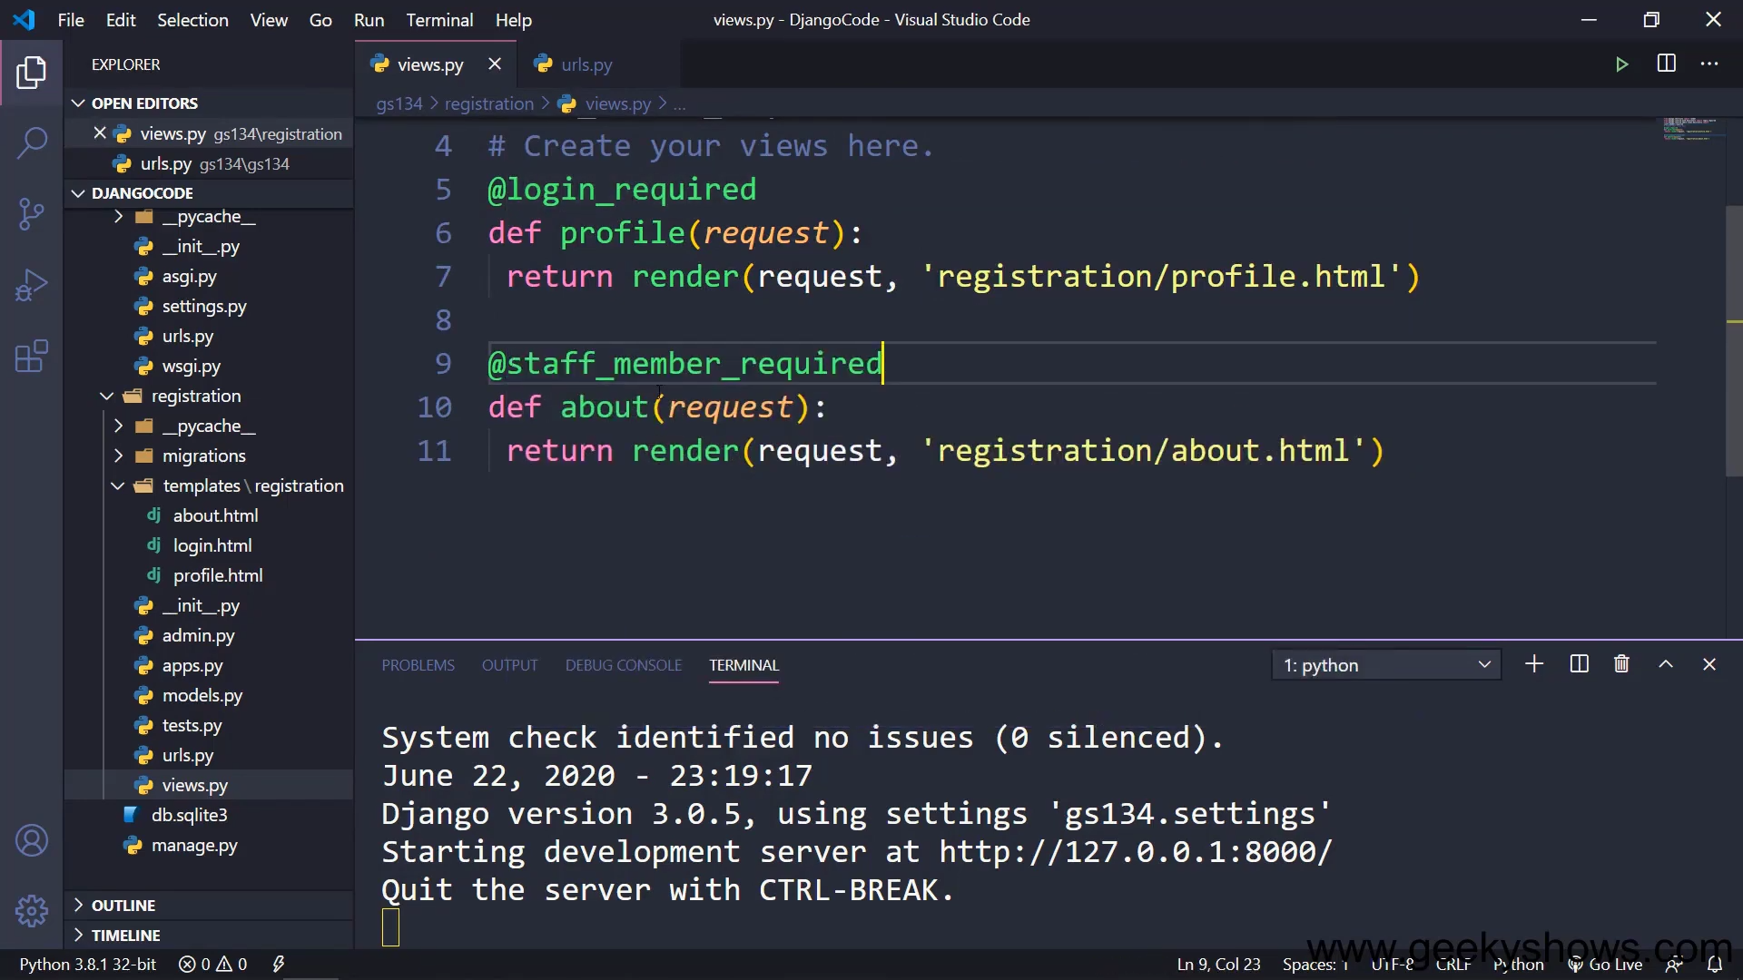

Slide 29
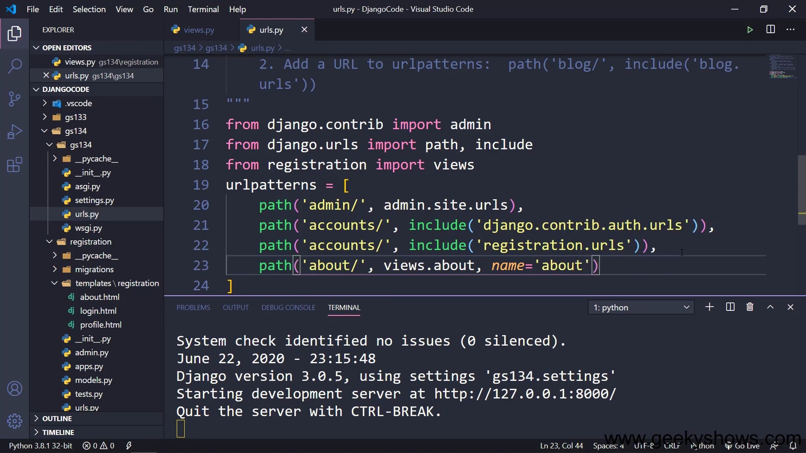

Slide 30
120. How to use Authentication Views with Class Based View in Django

Slide 31
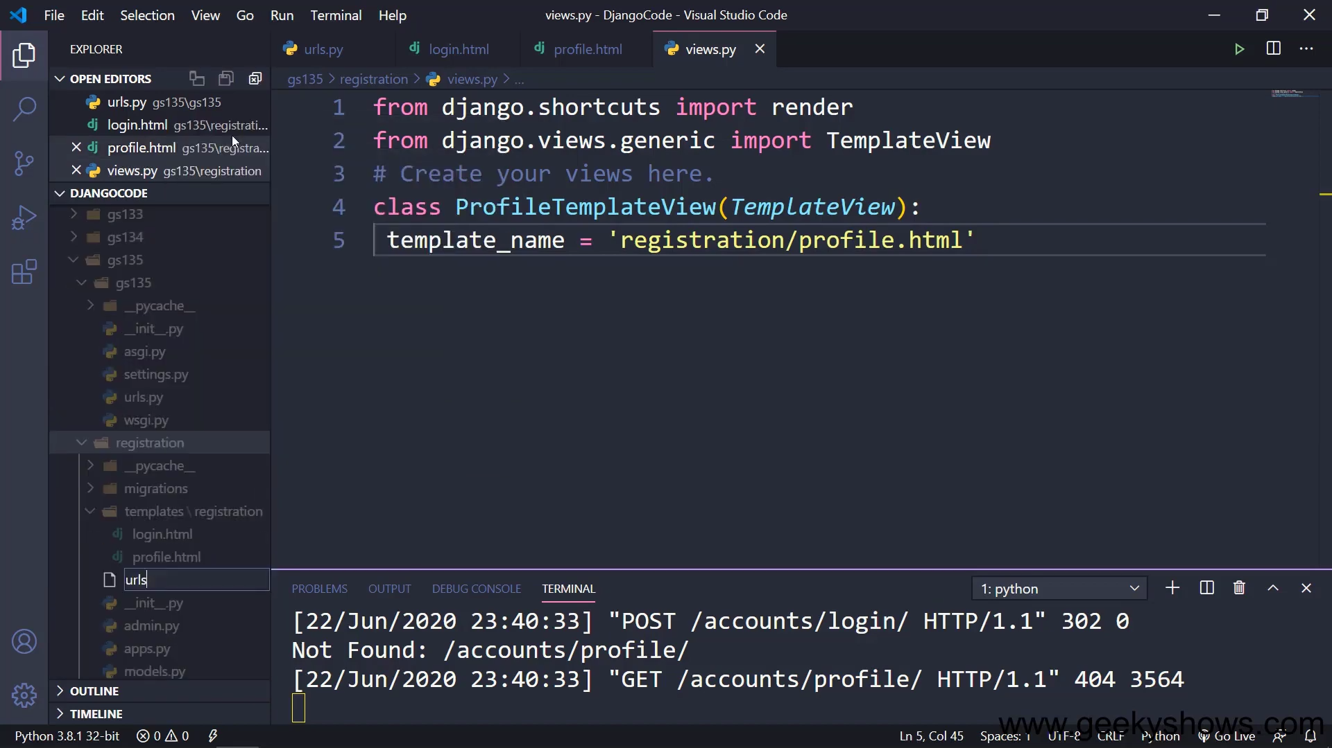

Slide 32
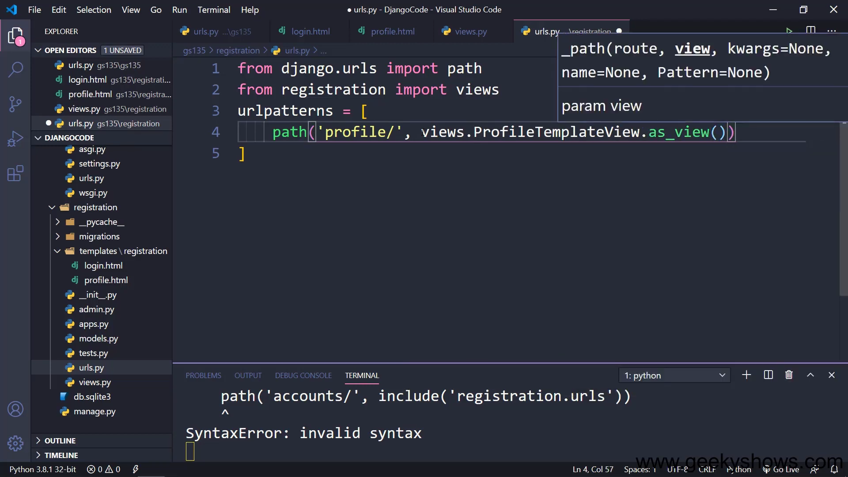

Slide 33
121. Class Based View with login required and staff member required Decorators in Django

Slide 34
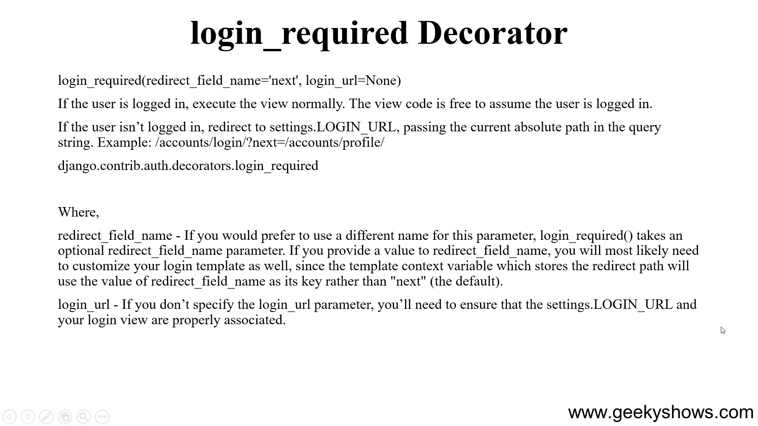

Slide 35
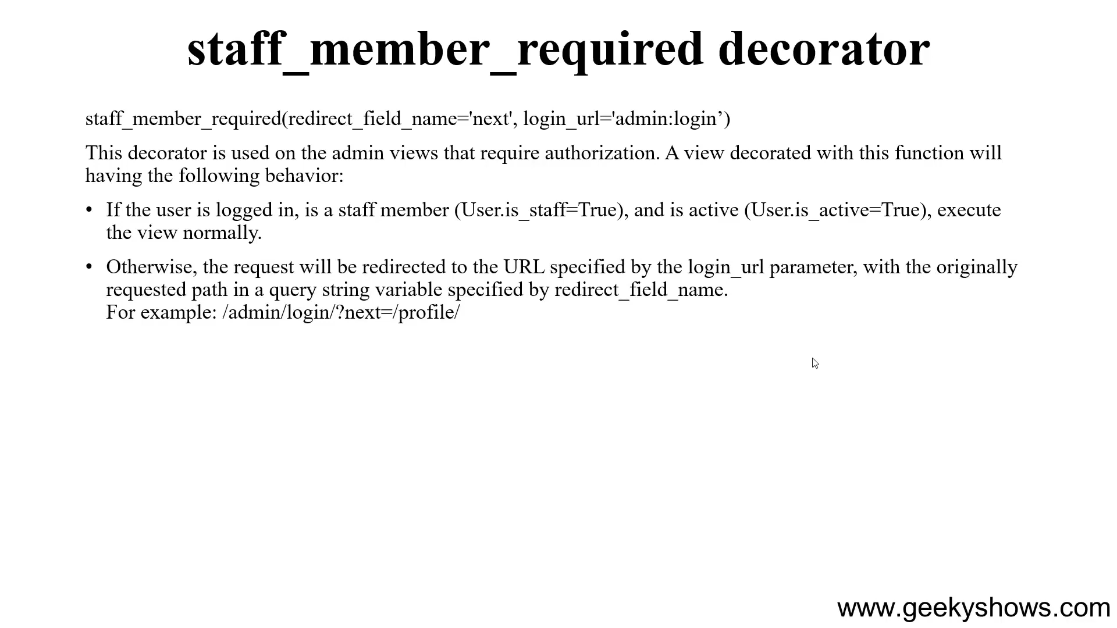

Slide 36
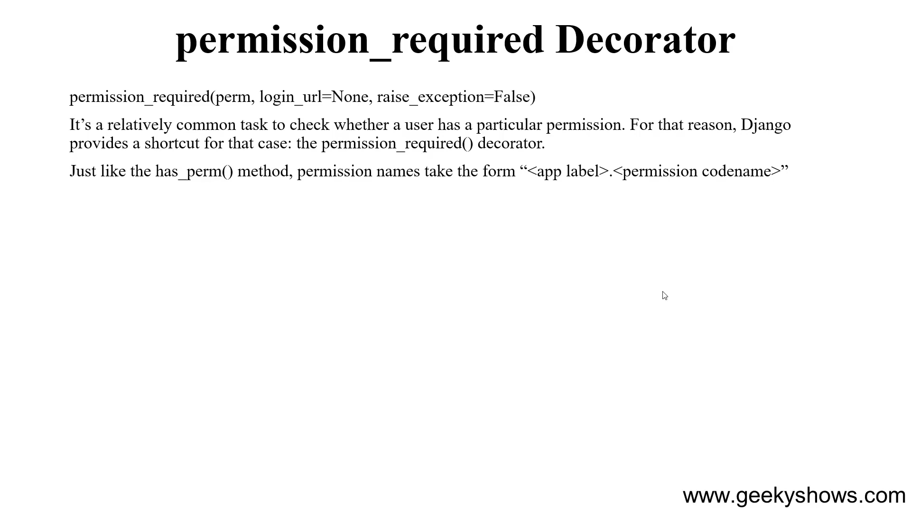

Slide 37
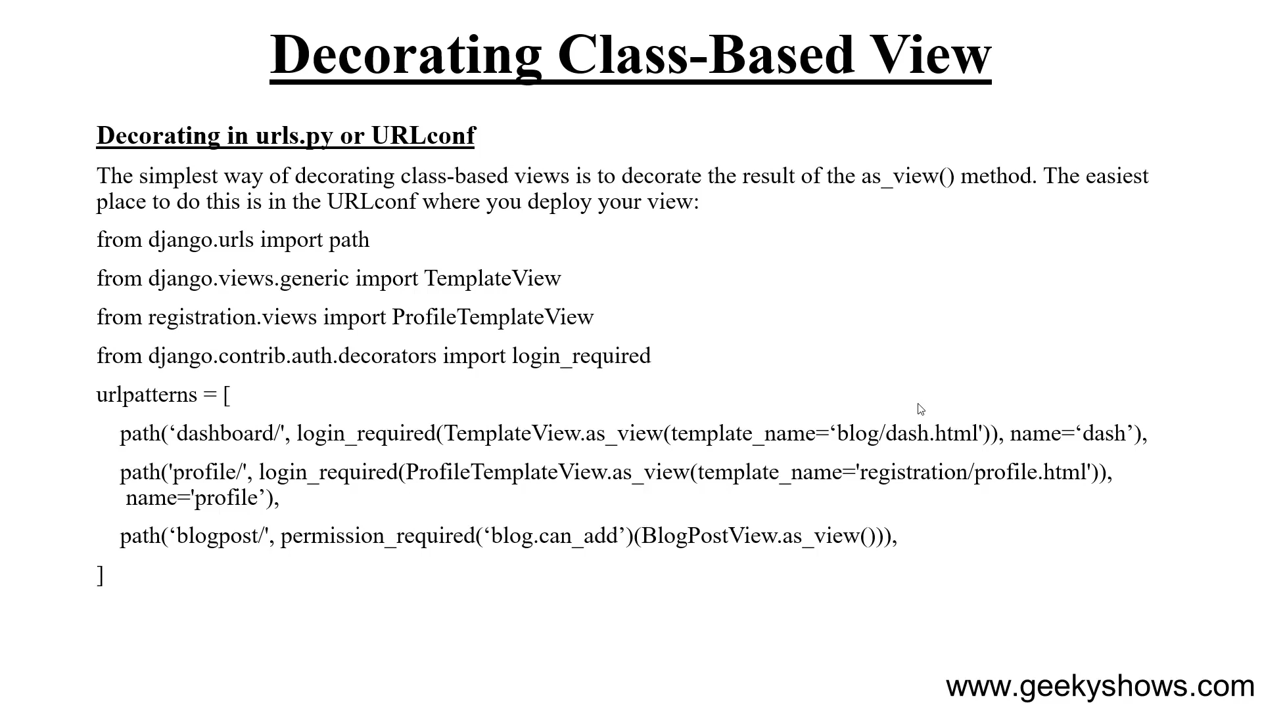
Doesn't work for each instance
Of the class

Slide 38
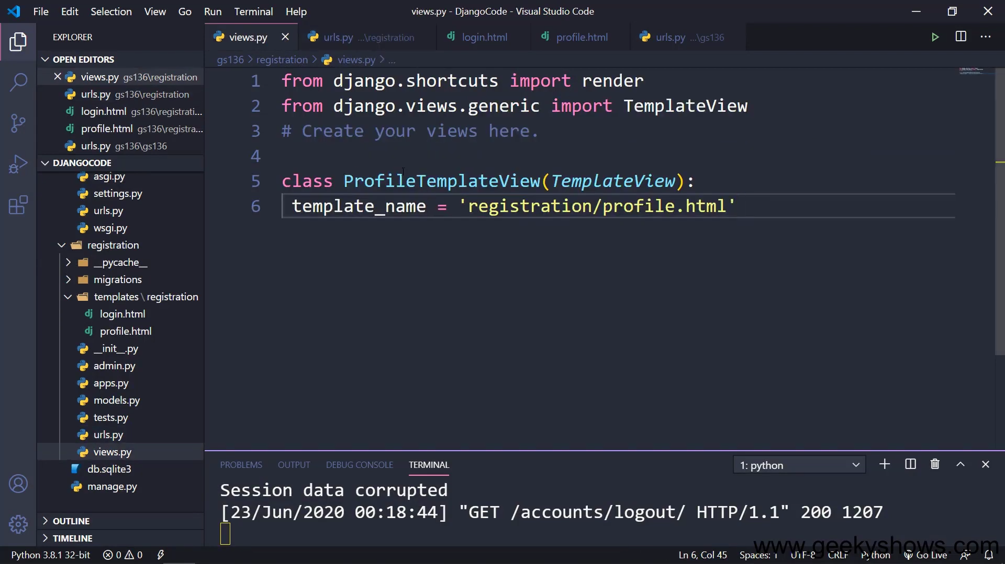

Slide 39
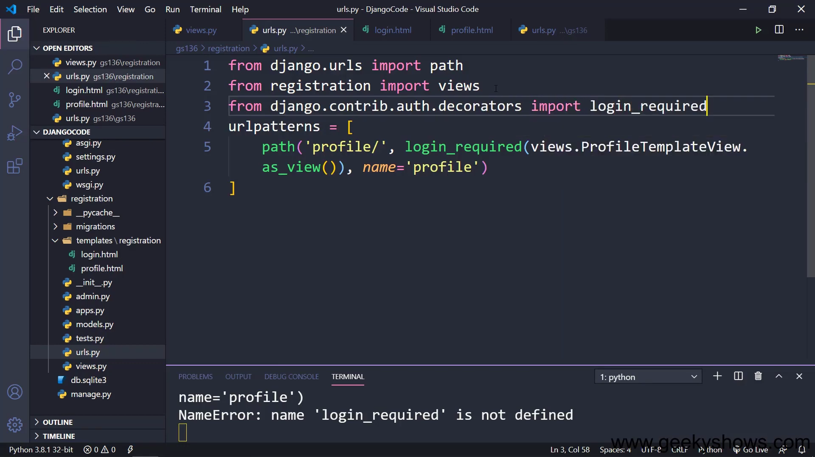

Slide 40
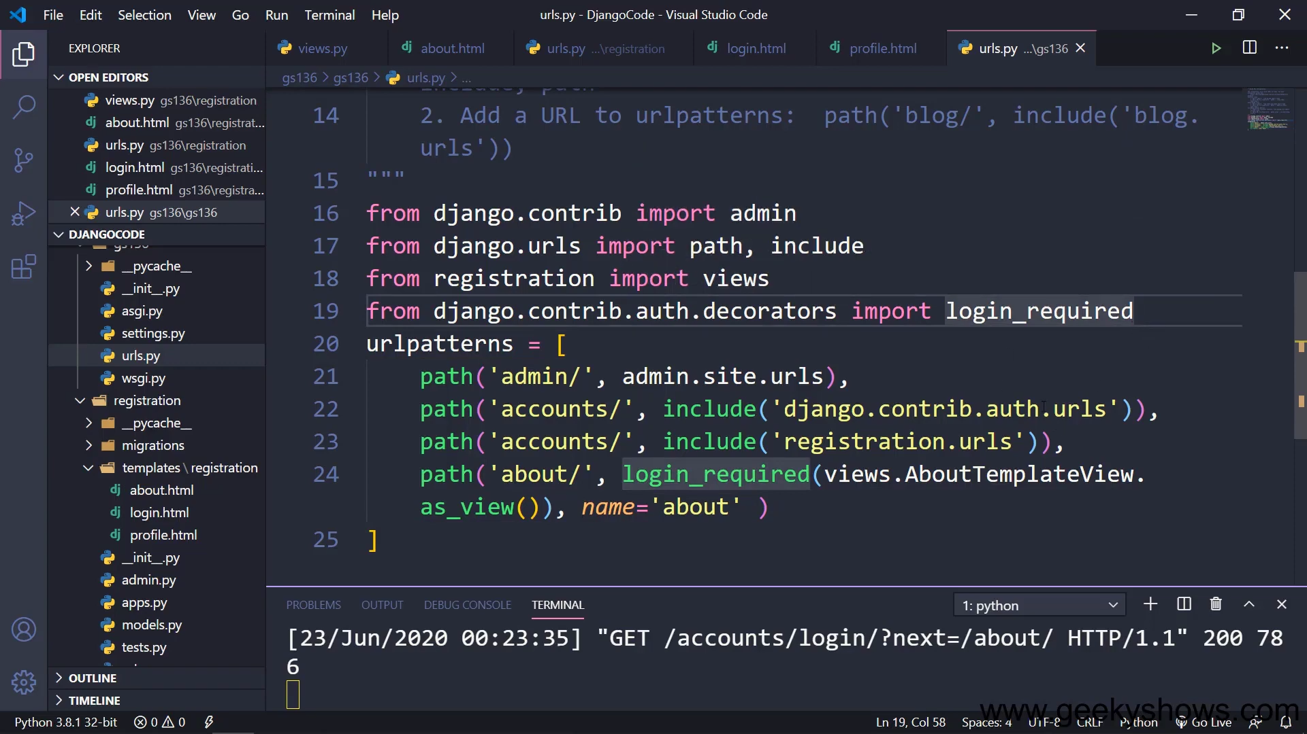

Slide 41
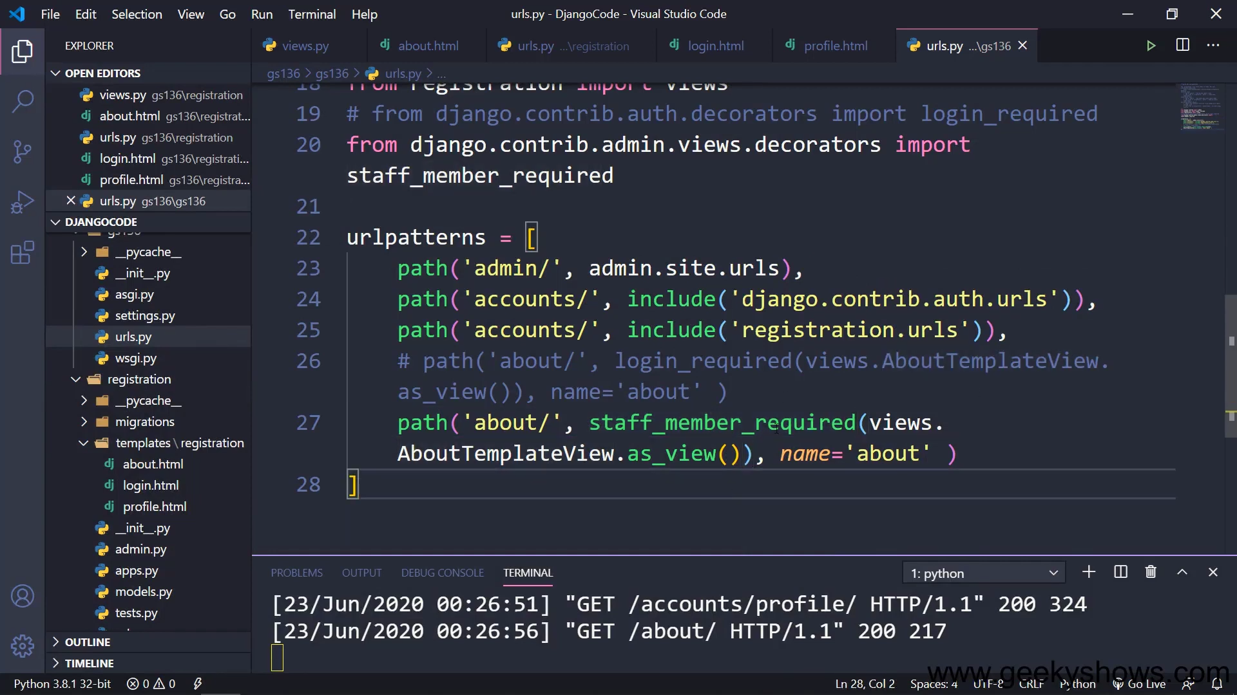

Slide 42
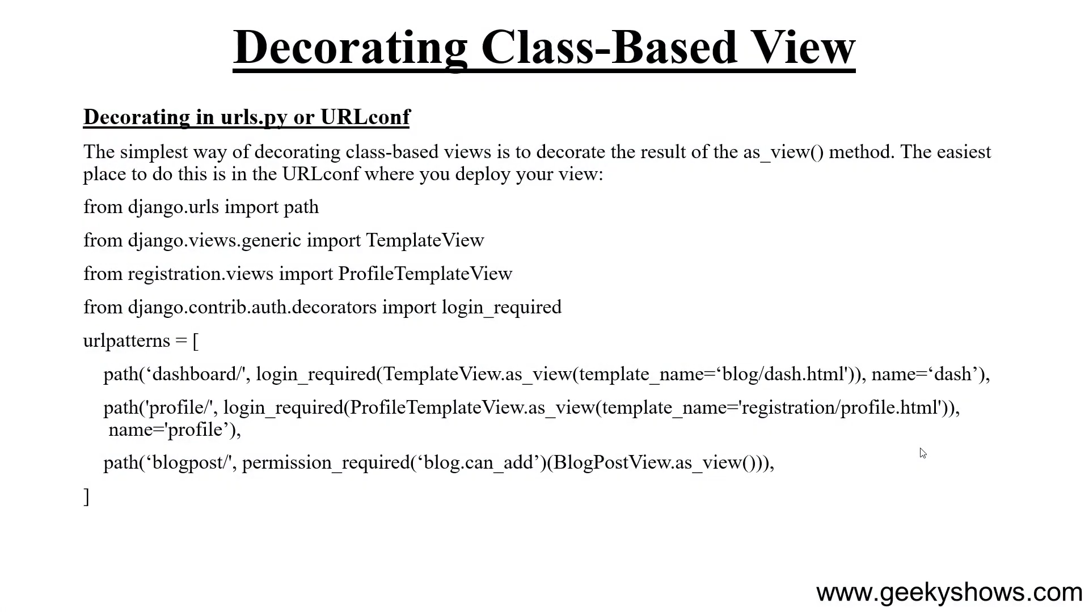

Slide 43
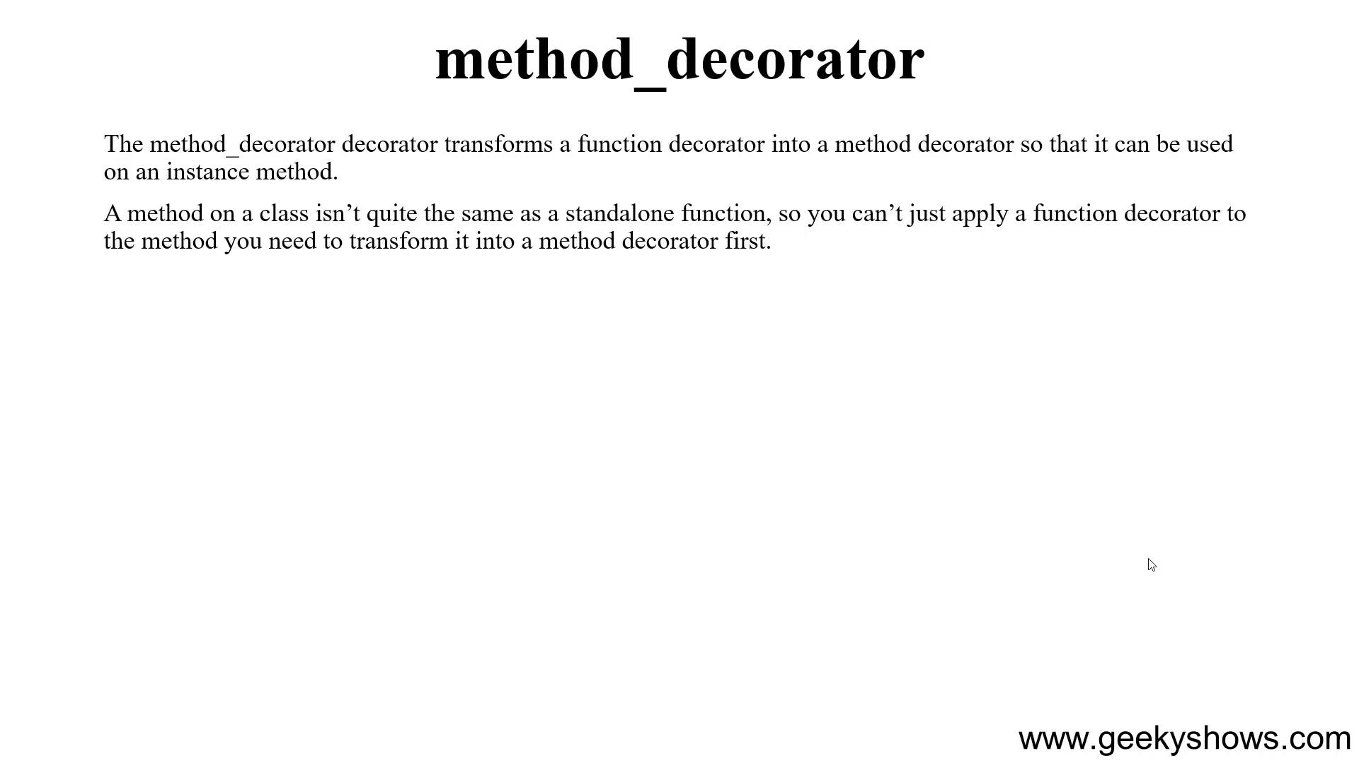

Slide 44
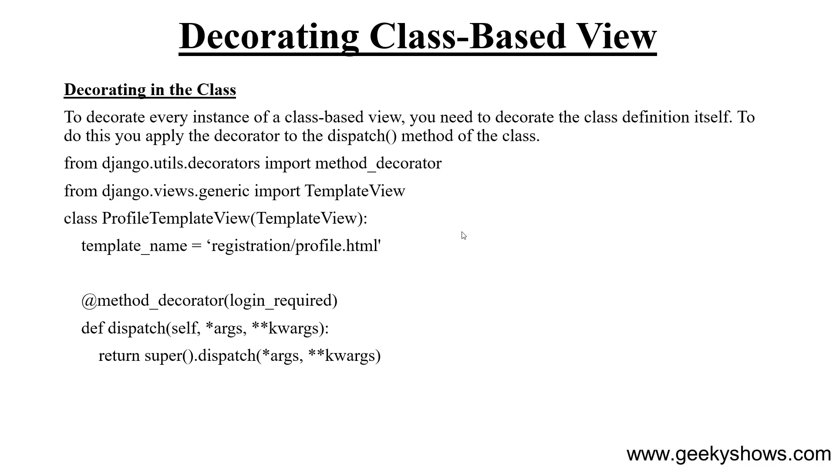
WAY 1

Slide 45
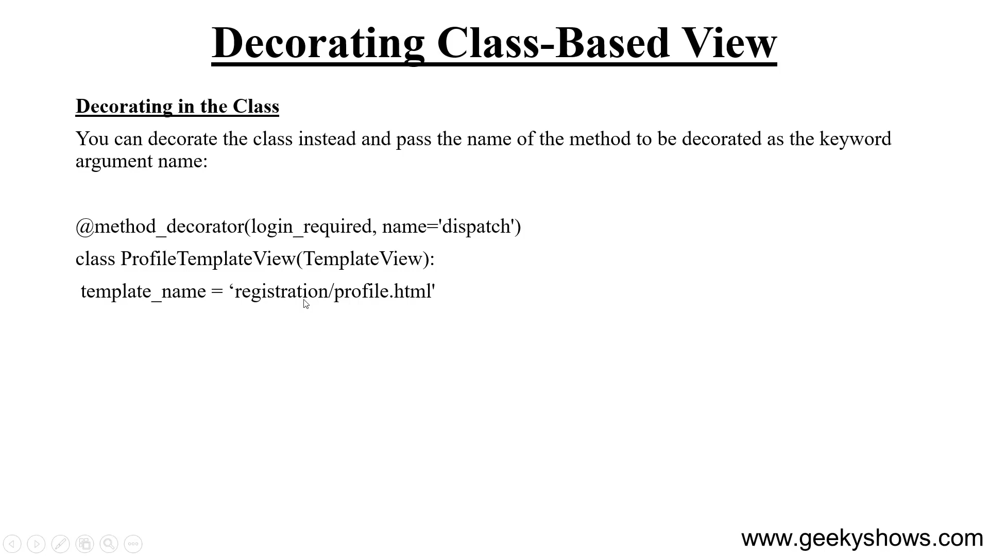
WAY 2

Slide 46
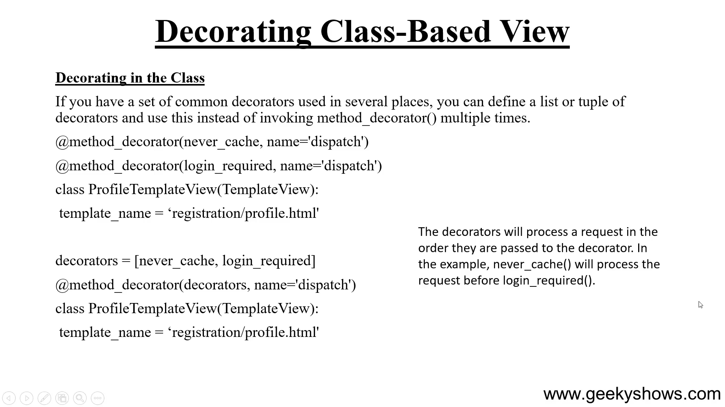

Slide 47
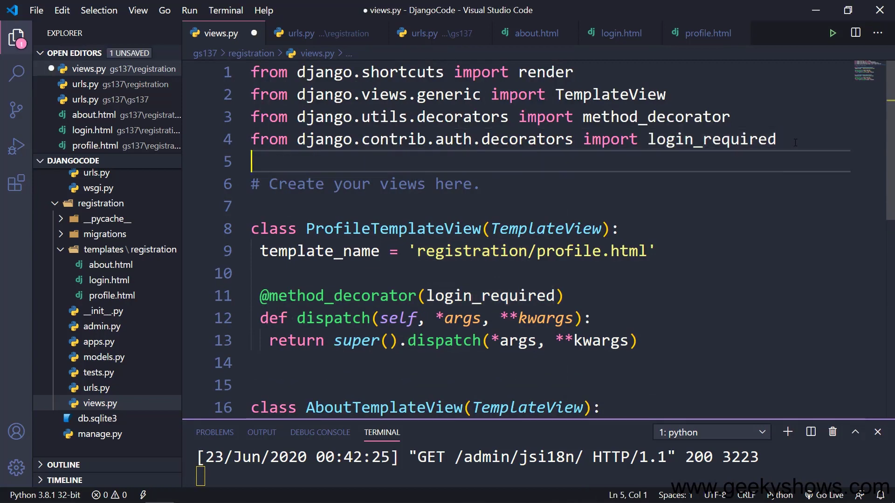

Slide 48
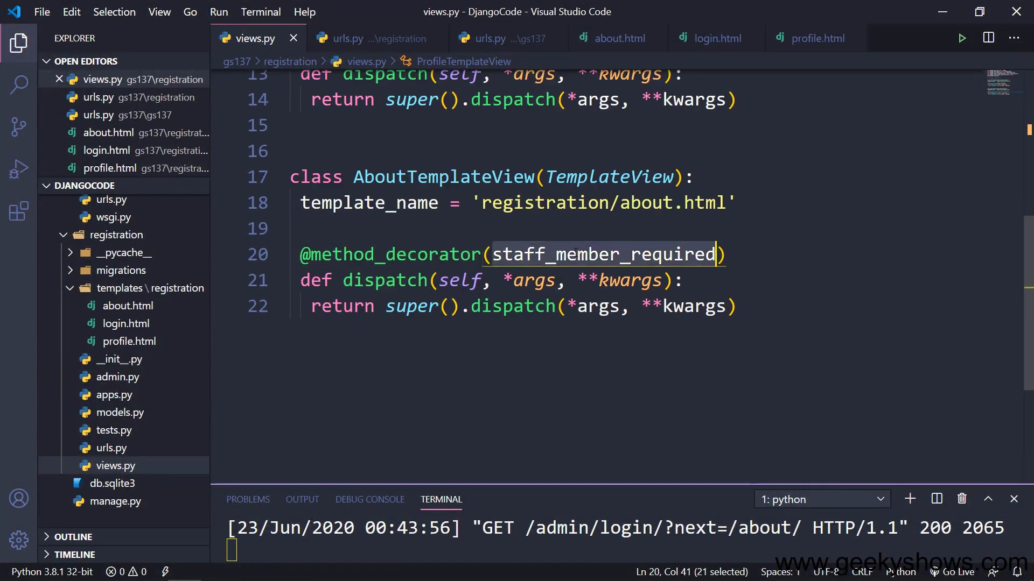

Slide 49
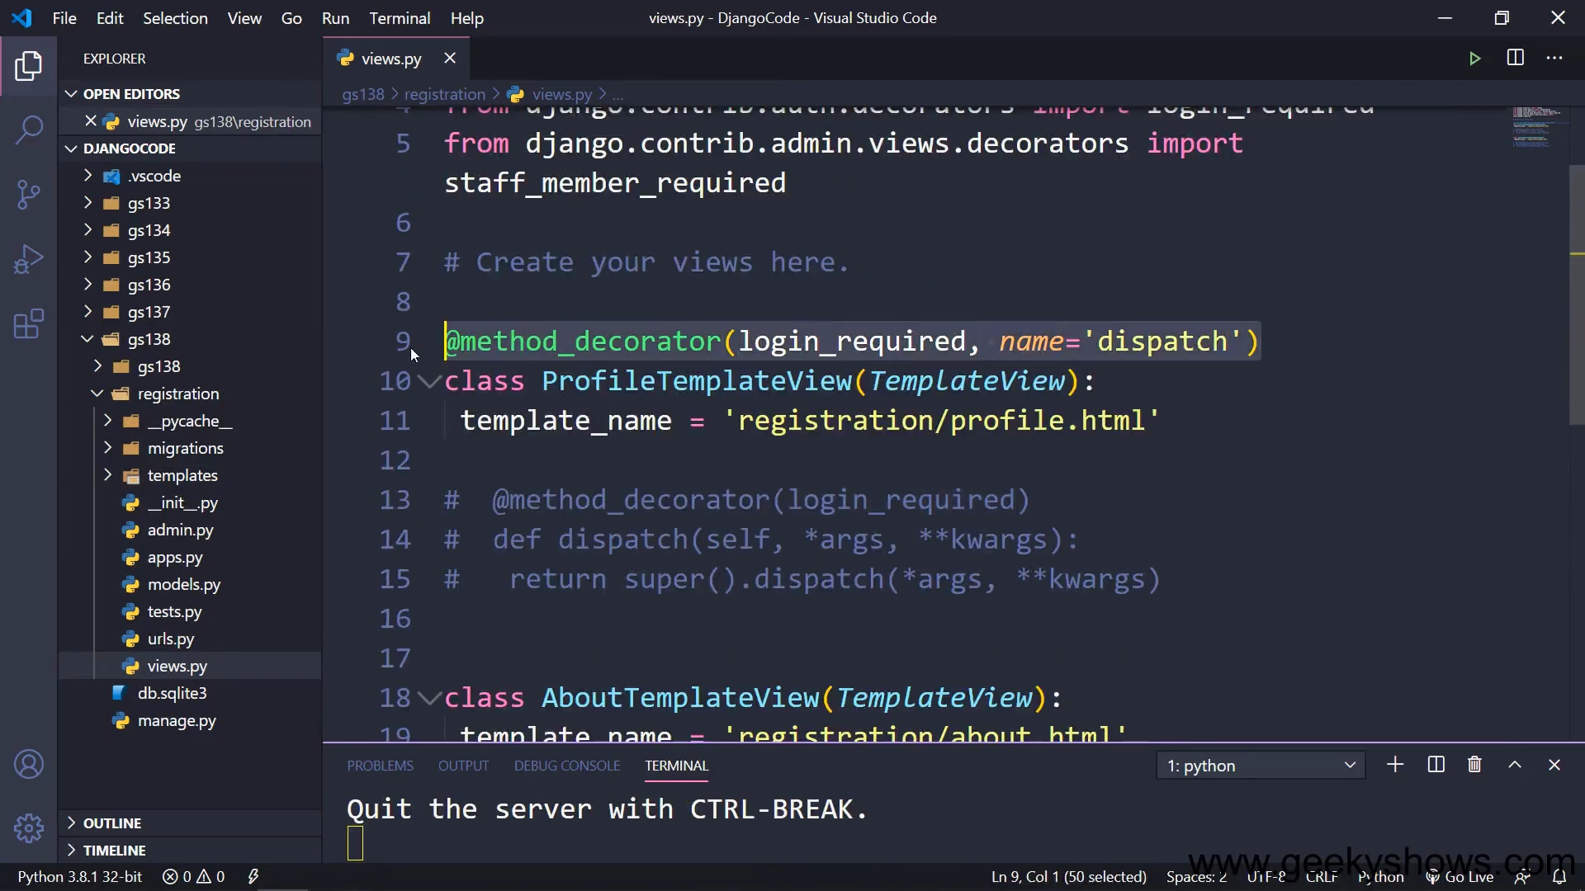

Slide 50
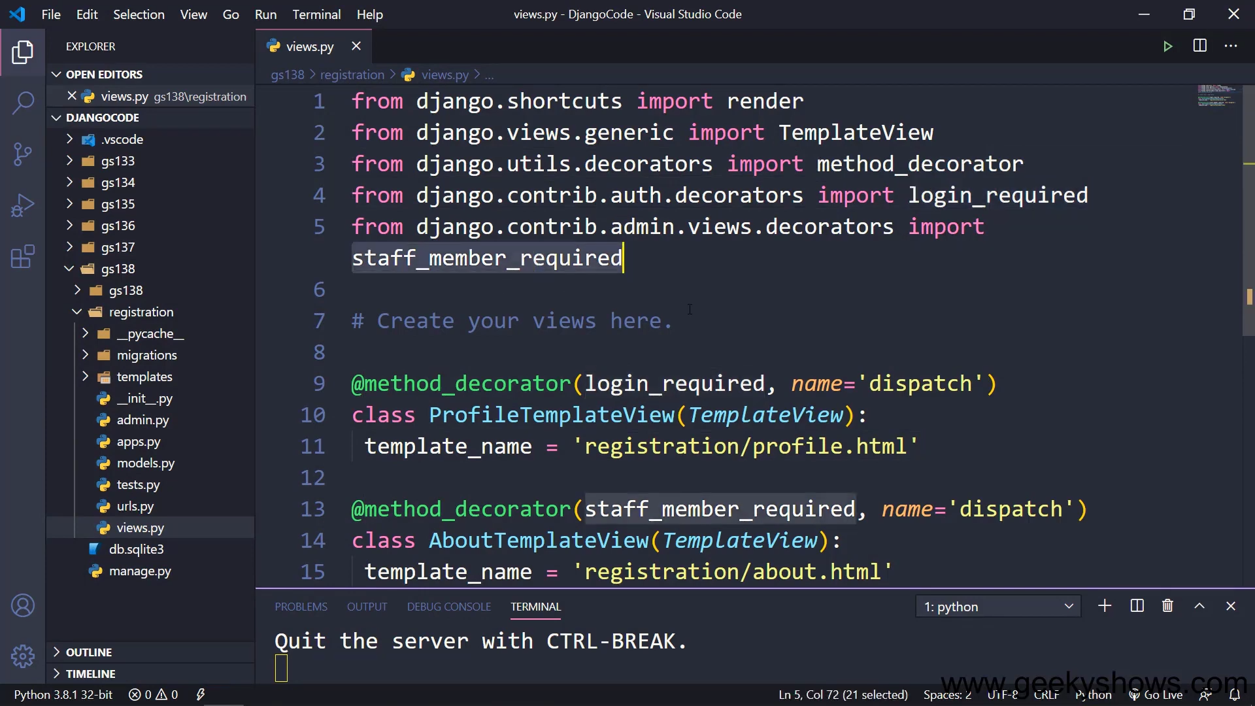

Slide 51
122. Customize Authentication View in Django

Slide 52
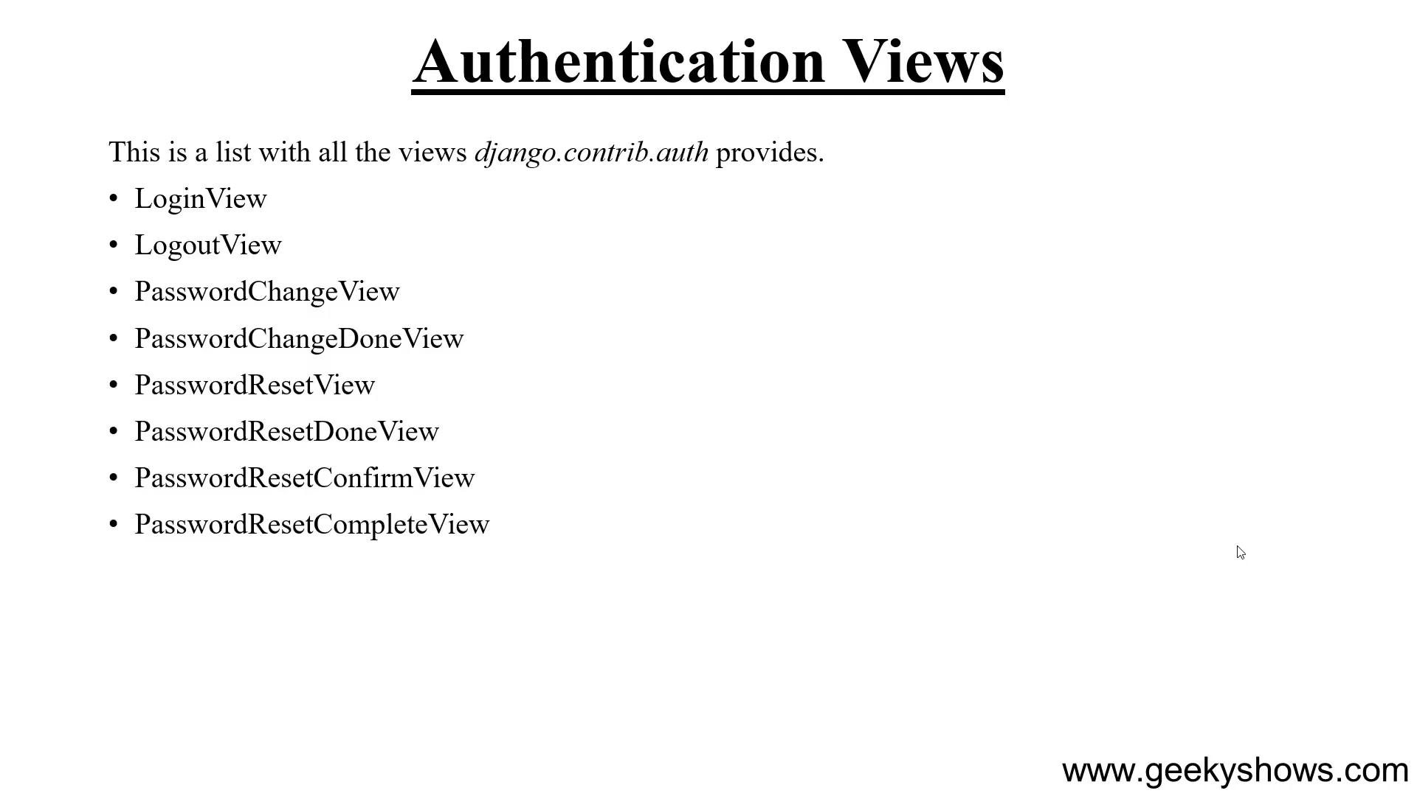

Slide 53
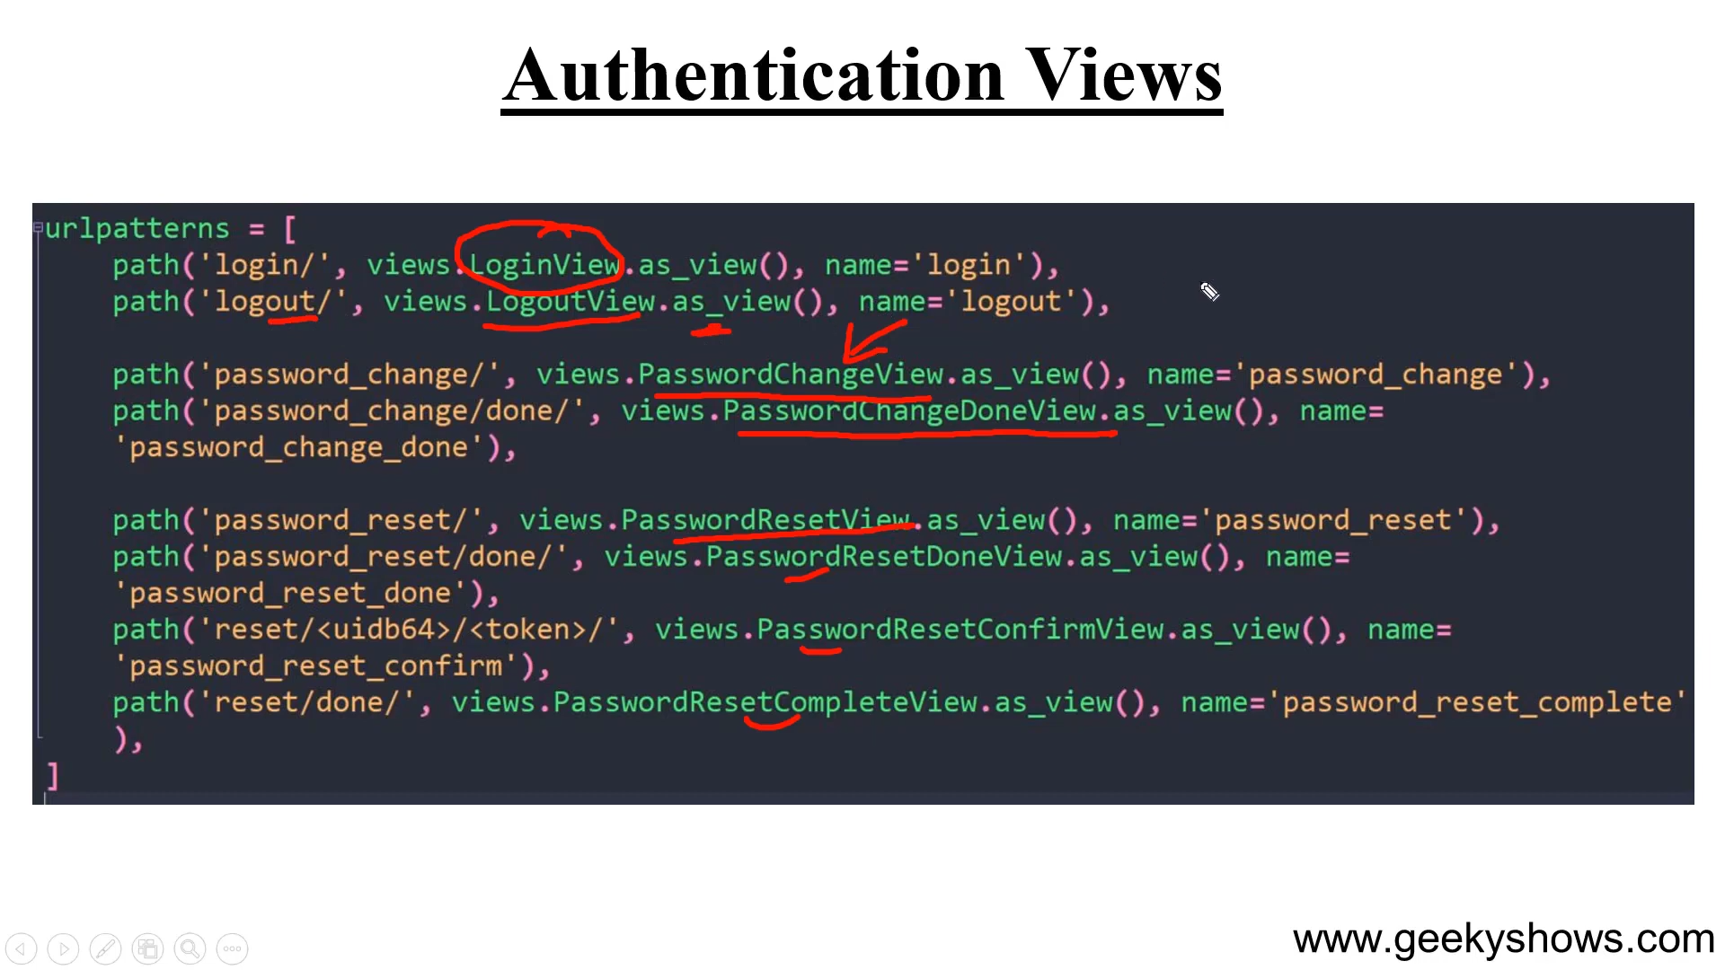

Slide 54
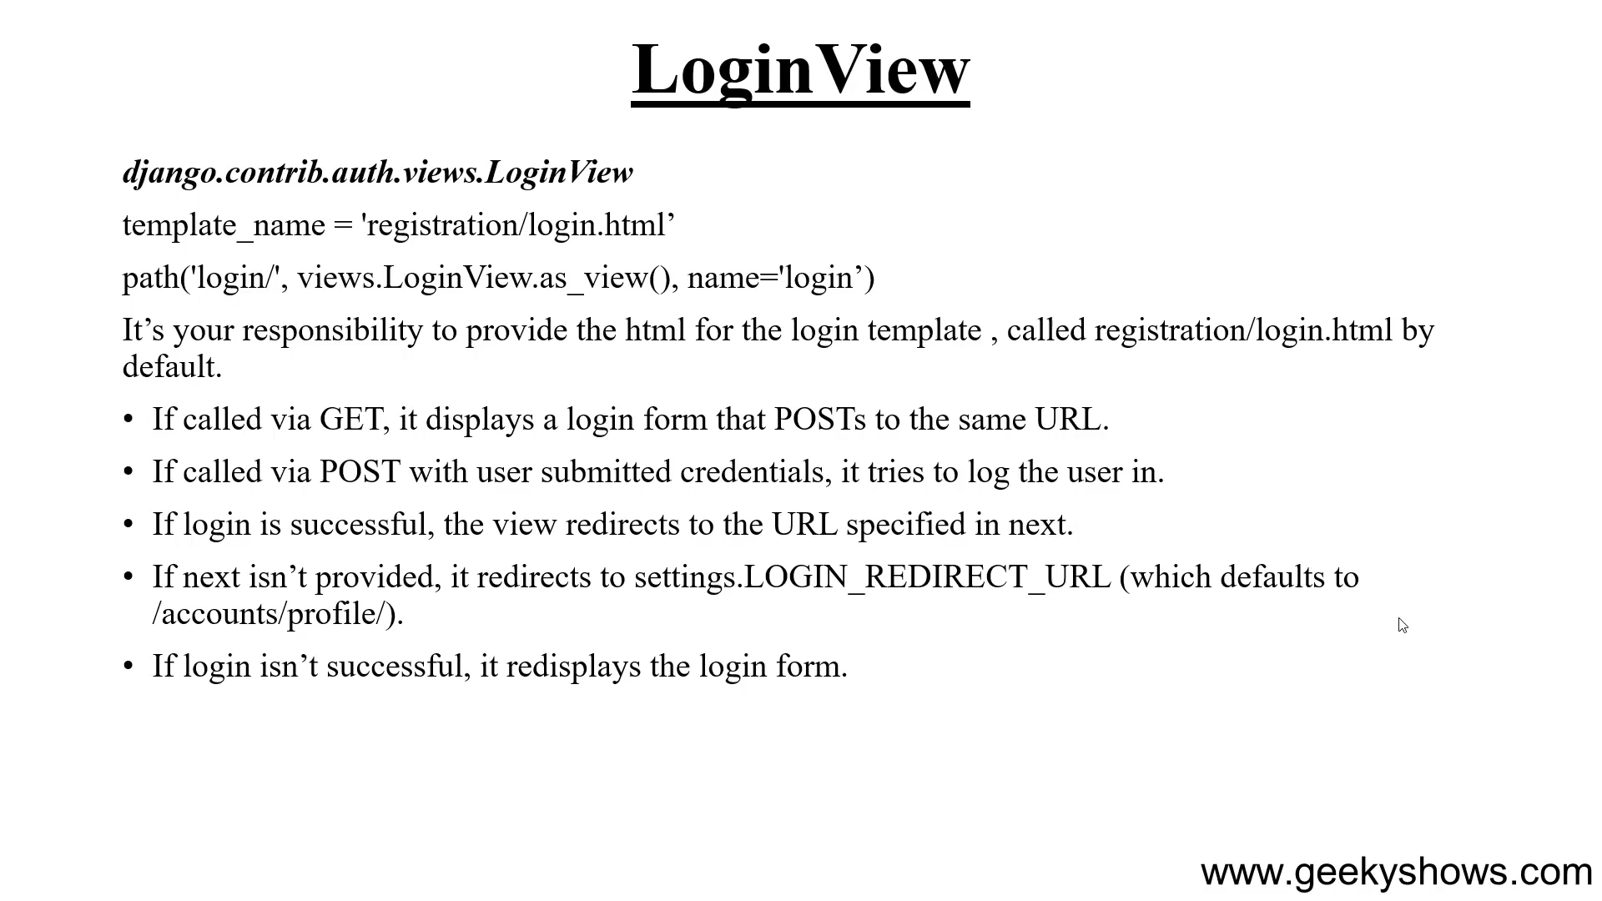

Slide 55
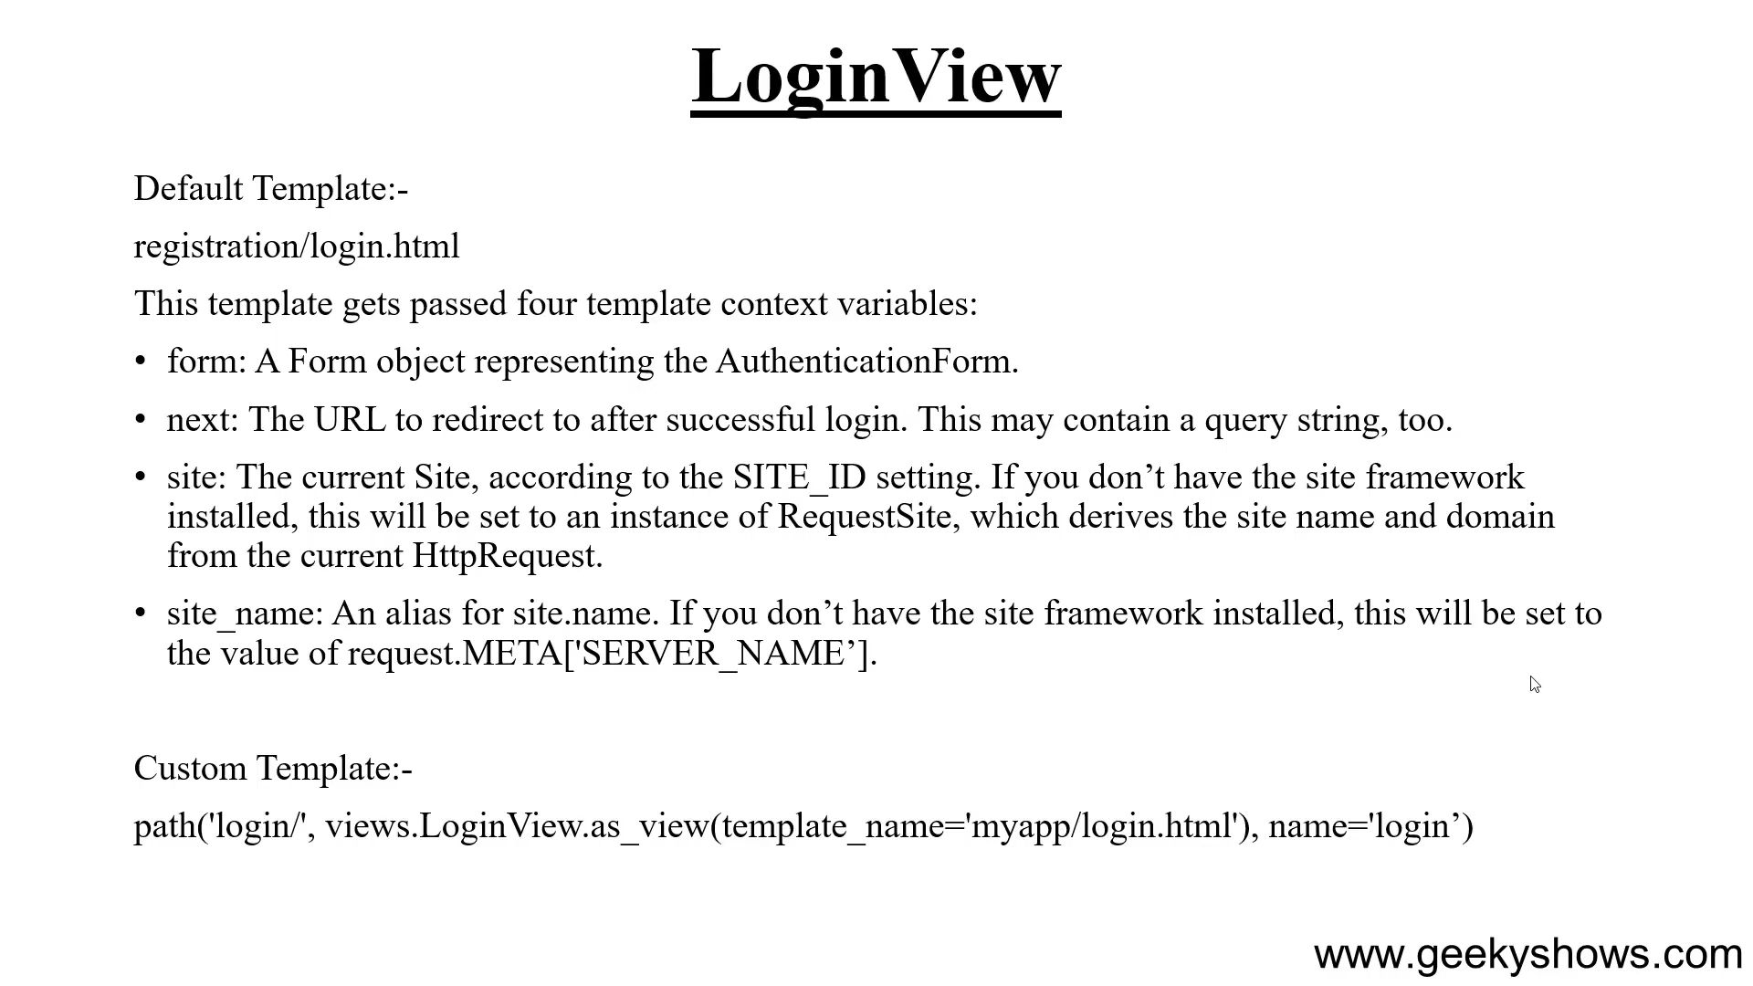

Slide 56
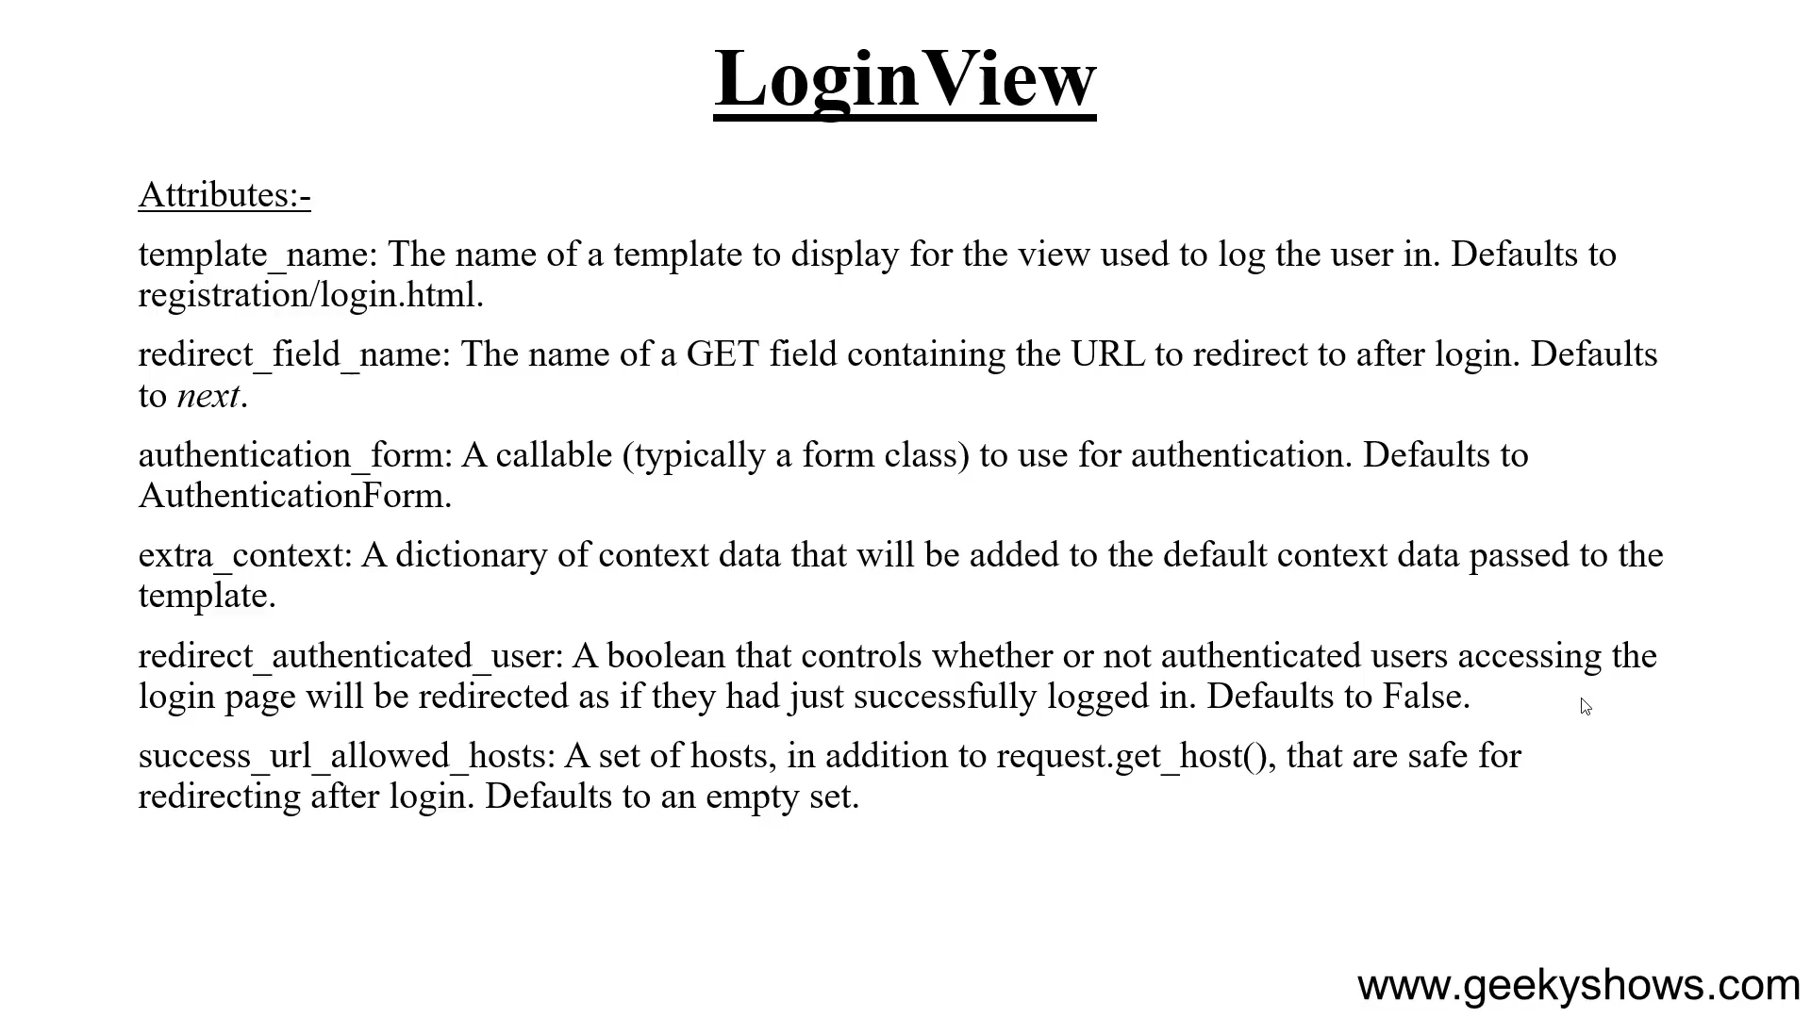

Slide 57


Slide 58


Slide 59


Slide 60


Slide 61


Slide 63


Slide 64


Slide 65


Slide 66


Slide 67


Slide 68


Slide 69


Slide 70


Slide 71


Slide 72


Slide 73


Slide 74


Slide 75


Slide 76


Slide 77


Slide 78


Slide 79


Slide 80


Slide 81


Slide 82


Slide 83


Slide 84


Slide 85


Slide 86


Slide 87


Slide 88


Slide 89


Slide 90


Slide 91


Slide 92


Slide 93


Slide 94


Slide 95


Slide 96


Slide 97
123. Authentication Settings in Django

Slide 98


Slide 99


Slide 100


Slide 101


Slide 102
124. Database Configurations in Django

Slide 103


Slide 104


Slide 105


Slide 106


Slide 107
125. Pagination with Function Based View in Django

Slide 108


Slide 109


Slide 110


Slide 111


Slide 112


Slide 113


Slide 114


Slide 115


Slide 116


Slide 117


Slide 118

Needs to order by else gives warning

Slide 119


Slide 120


Slide 121


Slide 122


Slide 123


Slide 124


Slide 125


Slide 126
126. Pagination with Class Based View in Django

Slide 127


Slide 128

To handle 404 [if page number does not makes sense ]
self

Slide 129

OR

Slide 130

Instance of page class when using class base view

Slide 131


Slide 132

Paginated_by na thakle

Slide 133

Pagineted hoilei dekhabe na hole dekhabe na

Slide 134


Slide 135

Paginated na hoile
All queryset

Slide 136


Slide 137


Slide 138
127. Django Security

Slide 139


Slide 140


Slide 141


Slide 142
128. Django Completed Now What Next

Slide 143


